Slide 1

INTRODUCTION
TO GIT & GITHUB

Slide 2

GIT != GITHUB
Git and Github are two separate tools that accomplish two separate goals
They interface with one another to make a nice pipeline for team coding that is less likely to catastrophically fail

Slide 3
Let’s see how git can help us out

Slide 4
def main():
query = “SELECT * FROM customers”
table = sql.read(query)
customer_records = pd.DataFrame(table)
users = customer_records[‘username’]
print(users.value_counts())
if __name__ == “__main__”:
main()
Let’s imagine that Janice sets out to write some code to generate a report.

Slide 5

def main():
query = “SELECT * FROM customers”
table = sql.read(query)
customer_records = pd.DataFrame(table)
users = customer_records[‘username’]
print(users.value_counts())
if __name__ == “__main__”:
main()
Hooray, Janice! You did a thing!

Slide 6
CODE DEVELOPMENT TIMELINE
Janice writes code.
Code put into production. It’s ugly code.

Slide 7
CODE DEVELOPMENT TIMELINE
Hey Janice. Fix your ugly code now.
Janice writes code.
Code put into production. It’s ugly code.

Slide 8
def get_data(query):
“””
Get’s the data from the database
and returns it in dataframe format
“””
table_data = sql.read(query)
return pd.DataFrame(table_data)
def print_user_report():
query = “SELECT * FROM customers”
customer_records = get_data(query)
users = customer_records[‘username’]
print(customer_records.value_counts())
if __name__ == “__main__”:
print_user_report()
Janice now sets out to functionalize her code and make it reusable and clear.
Janice breaks things.

Slide 9
CODE DEVELOPMENT TIMELINE
Idea for what the code should do.
Attempted changes break the code
The code is ugly, but it works.

Slide 10
We broke our code, now what?
With the code broken, we have two options.
Figure out how to fix the code
Reset to the last time the code worked

Slide 11
CODE DEVELOPMENT TIMELINE
Doing this can be very time consuming if you haven’t prepared for this eventuality. Let’s use git to prepare ourselves.

Slide 12
What does Git do?
Allows us to introduce a checkpointing system
Keeps track of each file’s evolution over time
Keeps a history of those changes and allows us to return to a version of our code at any time
Allows for multiple versions of the same code to exist simultaneously (we’ll come back to this one)

Slide 13
CODE DEVELOPMENT TIMELINE
|
Checkpoint!

Slide 14
CODE DEVELOPMENT TIMELINE
|

Slide 15
CODE DEVELOPMENT TIMELINE
|
OOPS. REVERT.

Slide 16
CODE DEVELOPMENT TIMELINE
|
X

Slide 17
CODE DEVELOPMENT TIMELINE
|

Slide 18
Git Checkpointing
This checkpointing system is made up of things called “commits.” A commit is essentially a time stamp where git knows what all the files in the project look like. It remembers the code in each file so we can always get back to that version. Hence why git is called “version control.”
To actually make a commit, we need to understand the 3 phases of git.

Slide 19
Working Directory
Staging Area
Repository
Git is made up of three independent “phases” of code tracking. Let’s investigate each section.

Slide 20
The working directory area is our “normal” file system. This tracks the code as it exists on our computer right now. If we’ve made changes, then the working directory sees all of those changes. It doesn’t track any history. It just says, “this is how my code looks right now.”
Working Directory
Staging Area
Repository

Slide 21
The staging area is how we prepare for a commit. Before making a commit, we’ll tell git that we want certain files to be “staged” for the commit (in non-git terms, we’re telling git that we want it to check this file to see if it’s changed since the last checkpoint).
Working Directory
Staging Area
Repository

Slide 22
The repository is where all of our checkpoints live. Every time we make a commit, all of those changes are pushed into the repository. The repository is the holder of all knowledge about each version of a project. Until the code is committed to the repository, no checkpoints have been made.
Working Directory
Staging Area
Repository

Slide 23
Working Directory
Staging Area
Repository
The flow of using Git

Slide 24
Working Directory
Staging Area
Repository
Code. Code. Code.
I work on my code in the working directory.

Slide 25
Working Directory
Staging Area
Repository
Code. Code. Code.
Code. Code. Code.
Now let’s get it ready for a checkpoint. I need to tell git to ‘add’ it to the staging area.
Terminal:> git add my_code_file.py

Slide 26
Working Directory
Staging Area
Repository
Code. Code. Code.
Code. Code. Code.
At this point, I haven’t made the checkpoint, I’ve just prepared for it. Now let’s actually make the commit.

Slide 27
Working Directory
Staging Area
Repository
Now we’ve actually made a commit. All the things in the staging area are added to the repository and a special name is given to this version of the code to represent the checkpoint.
Code. Code. Code.
Code. Code. Code.
Code. Code. Code.
Terminal:> git commit –m “making my first checkpoint”

Slide 28
Working Directory
Staging Area
Repository
This is called a “commit message” and it’s vitally important that you take it seriously. The special name that git gives to each checkpoint is just a series of characters like “d9rgy6431abql”. If you ever need to go back in time to a certain bit of code, you need to have a message that clearly identifies the commit’s purpose.
Code. Code. Code.
Code. Code. Code.
Code. Code. Code.
Terminal:> git commit –m “making my first checkpoint”

Slide 29
Commit Message Guide
Commit messages should:
Clearly state what’s changed since the last commit
Tell us what bugs were fixed, and what new code was added
If we remove the -m “message here” part from the previous example, we will be taken to a text editor to make our commit messages instead and can make it more specific.

Slide 30
Commit Message Guide
People opine at length about good commit messages. Here are some great blogs on the topic:
https://hackernoon.com/what-makes-a-good-commit-message-995d23687ad
https://chris.beams.io/posts/git-commit/

Slide 31
Working Directory
Staging Area
Repository
Code. Code. Code.
Code. Code. Code.
Code. Code. Code.
At this point our repository and our working directory match.
Code. Code. Code.

Slide 32
Working Directory
Staging Area
Repository
Code. Code. Code.
Code. Code. Code.
Code. Code. Code.
If we go through the process again, we can see that we’ll add a new commit that also lives in the repository.
Code. Code. YEAH.

Slide 33
Working Directory
Staging Area
Repository
Code. Code. Code.
Code. Code. Code.
Code. Code. Code.
If we go through the process again, we can see that we’ll add a new commit that also lives in the repository.
Code. Code. YEAH.
Code. Code. YEAH.
Code. Code. YEAH.

Slide 34
Working Directory
Staging Area
Repository
Code. Code. Code.
Code. Code. Code.
Code. Code. Code.
What if I want to revert to the original commit?
Code. Code. YEAH.
Code. Code. YEAH.
Code. Code. YEAH.

Slide 35
Git Log
There’s a command underneath git called git log. It displays a list of all the previous commits and information about them.

Slide 36
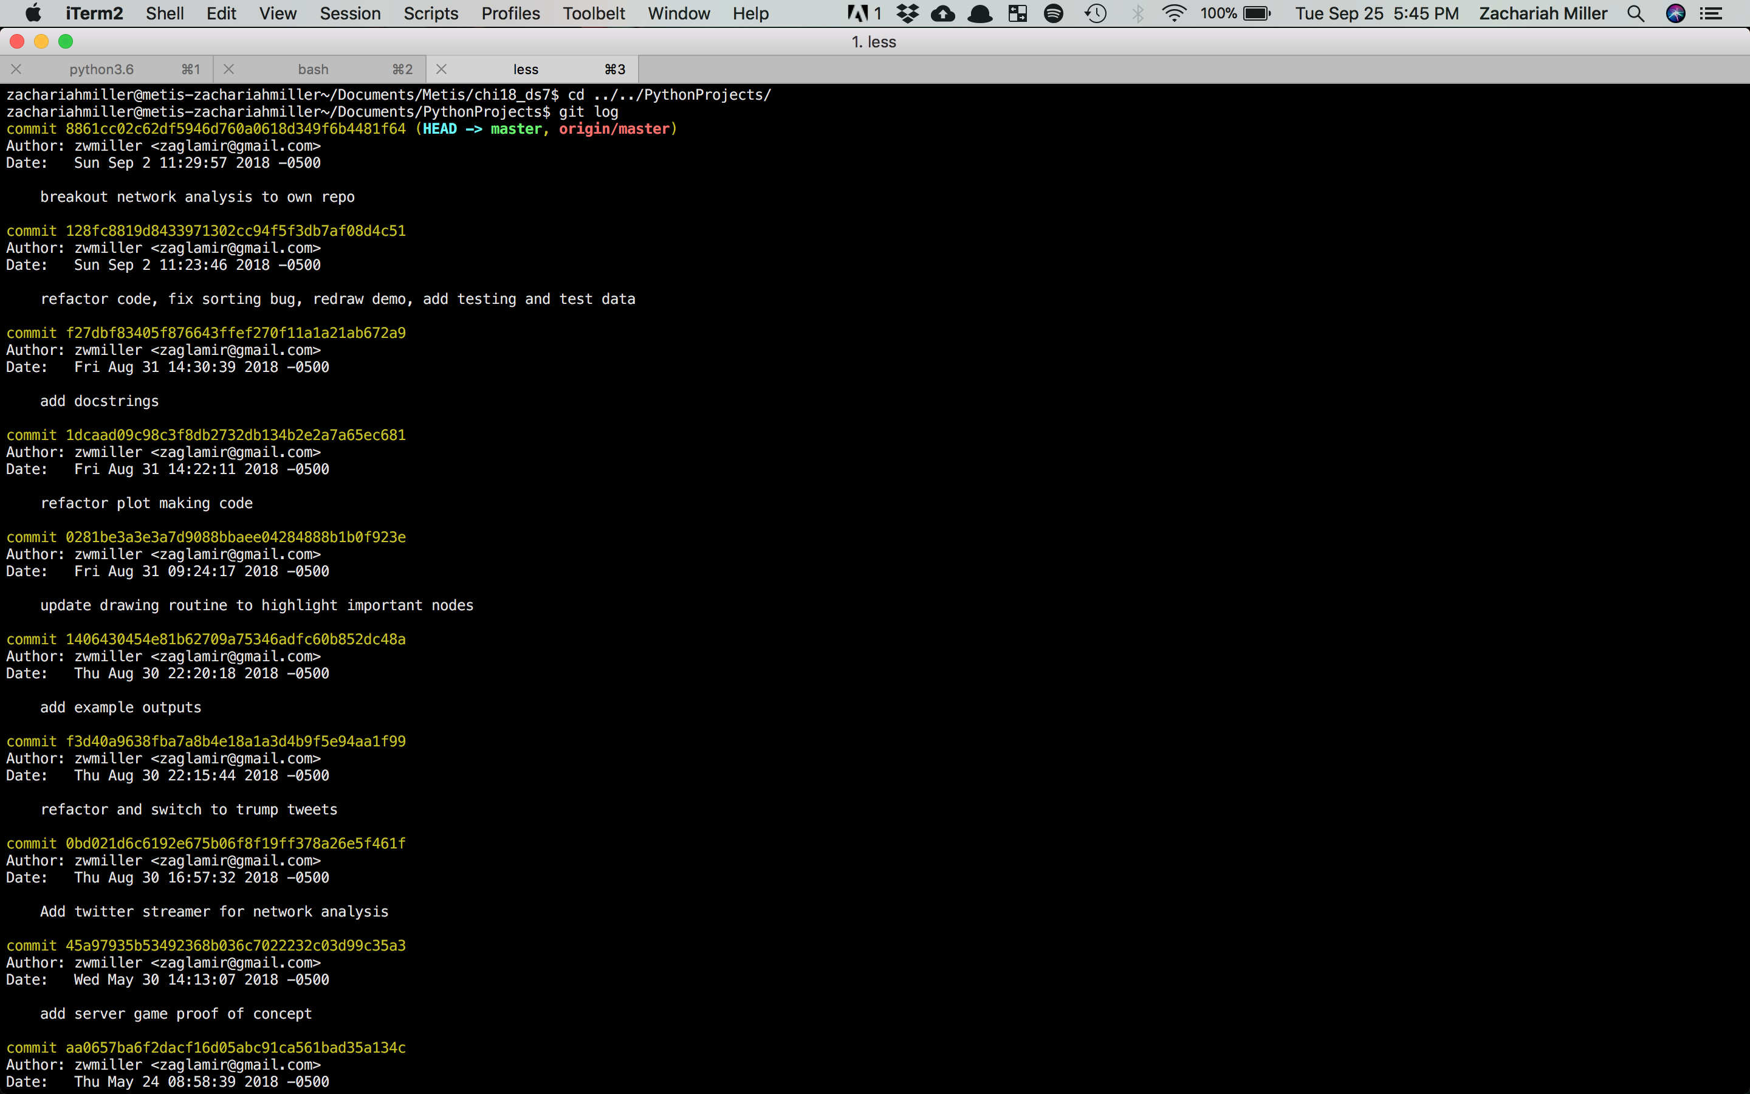

Slide 37
Commit IDs

Slide 38
Commit Messages

Slide 39
Git Reset
So if I want to return to a previous state of code, I can just find the correct commit id then tell git to reset to that state.
Terminal:> git reset 128fc8819d8433971302cc94f5f3db7af08d4c51

Slide 40
Working Directory
Staging Area
Repository
Code. Code. Code.
Code. Code. Code.
Code. Code. Code.
Before reset.
Code. Code. YEAH.
Code. Code. YEAH.
Code. Code. YEAH.

Slide 41
Working Directory
Staging Area
Repository
Code. Code. Code.
Code. Code. Code.
Code. Code. Code.
After reset.
Code. Code. Code.

Slide 42
Git: A quick review
Git gives us the ability to track our code over time
It gives us the history of our code, and the ability to reset to a previous status
It provides a flexible interface for making checkpoints (called commits)

Slide 43
Exercise: Building your first repo

Slide 44
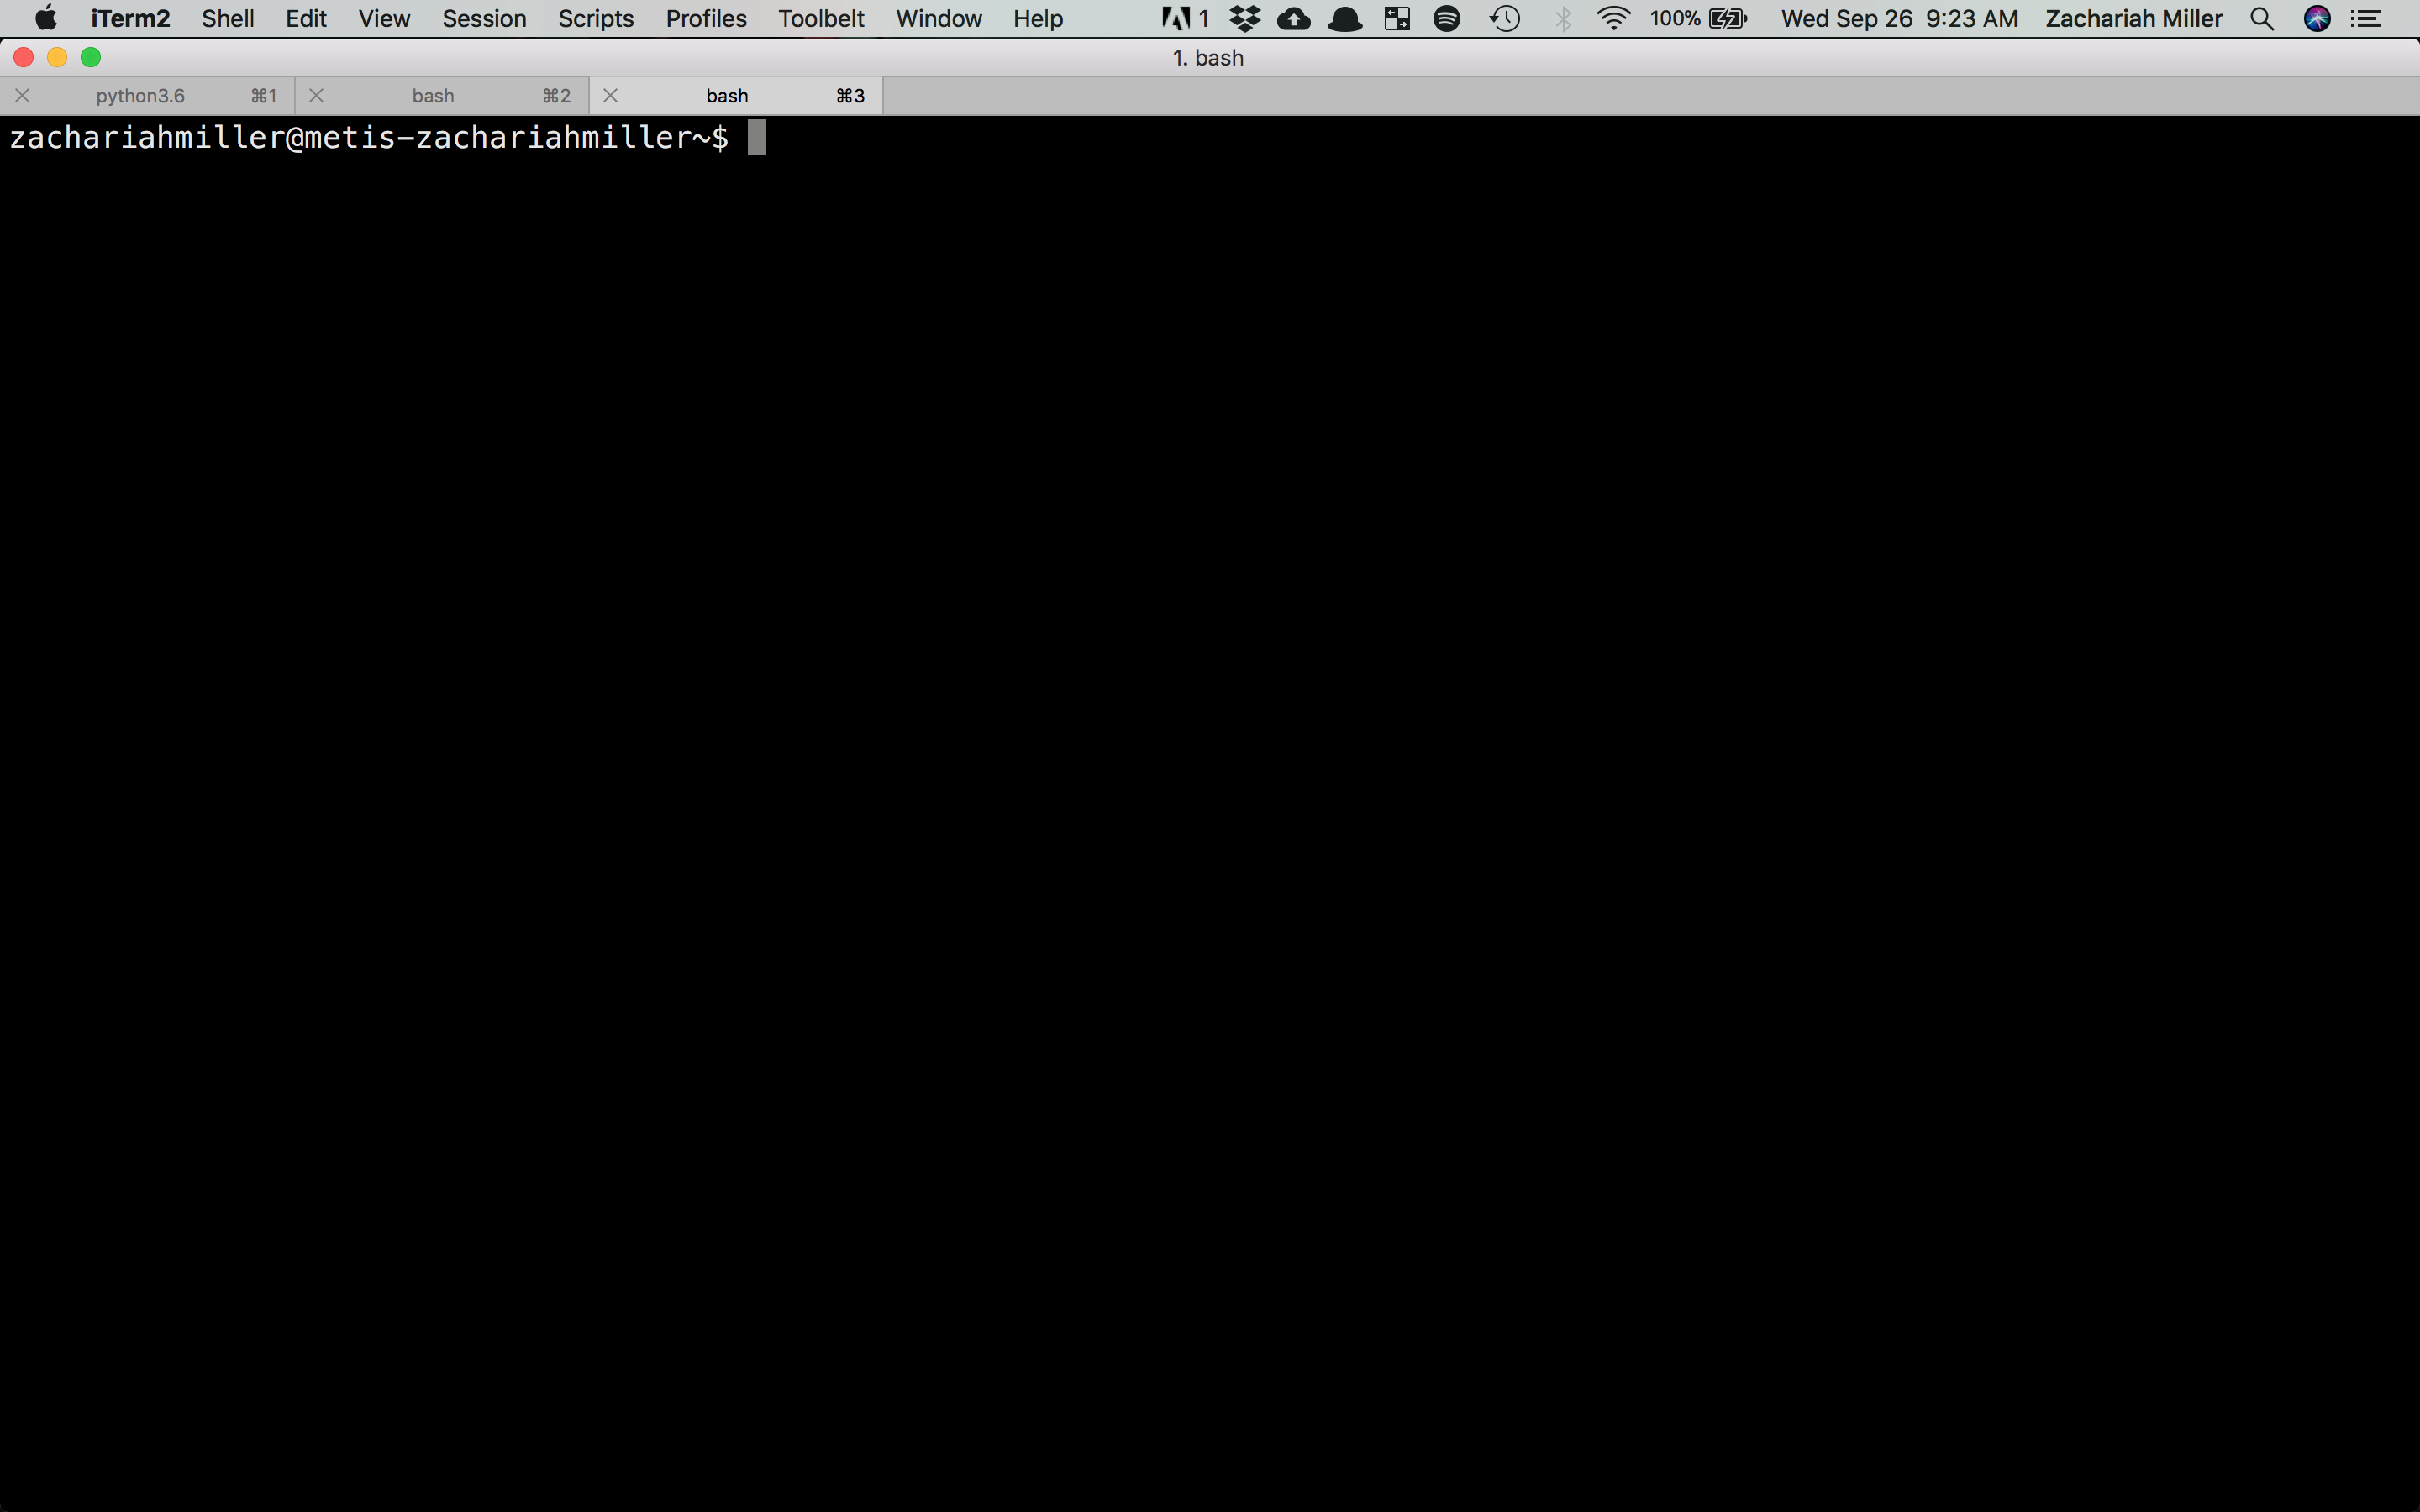

Slide 45
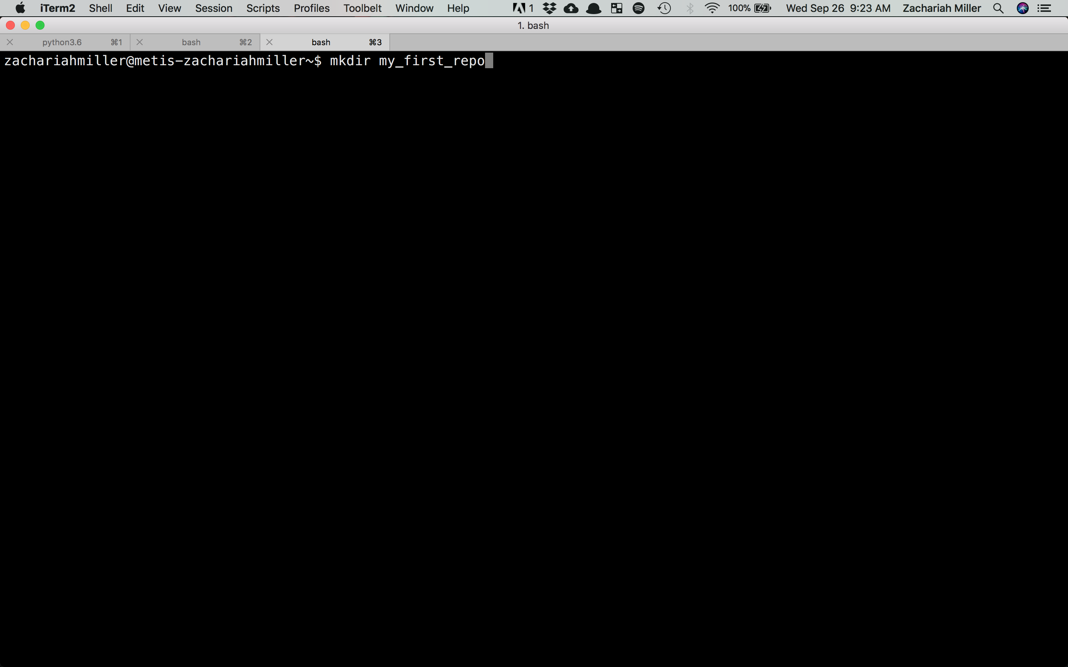

Slide 46
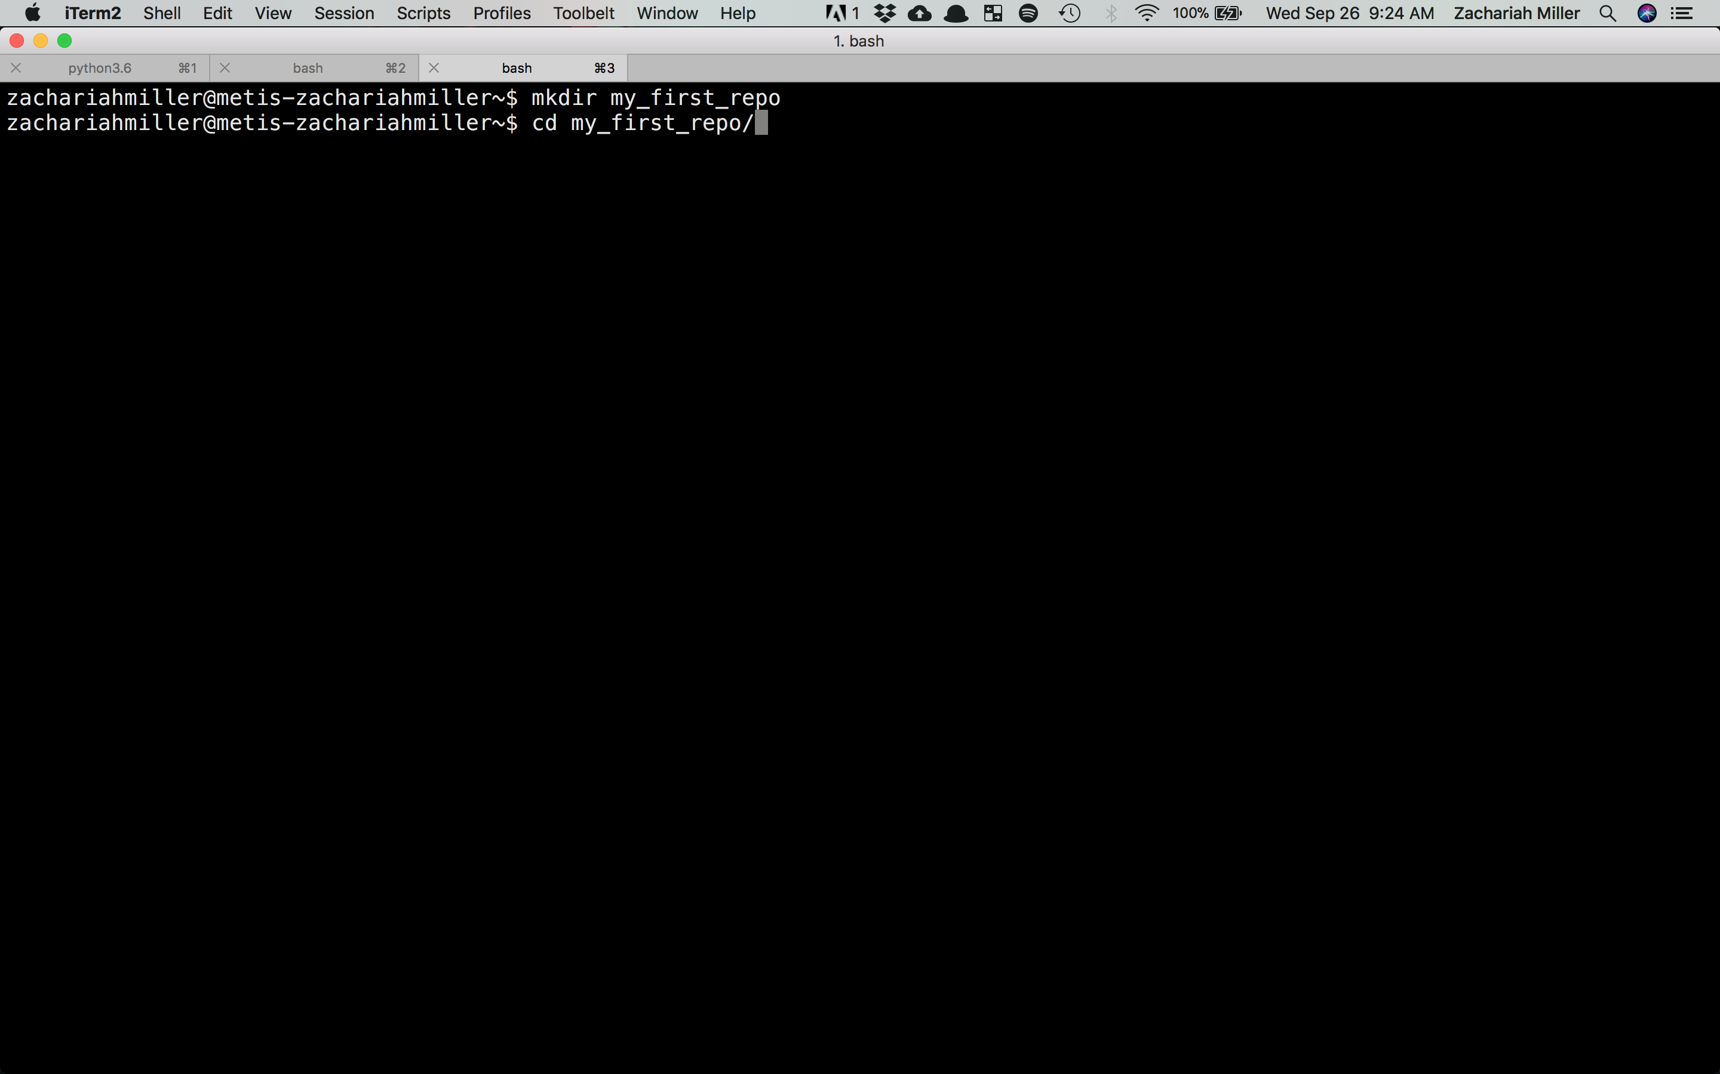

Slide 47
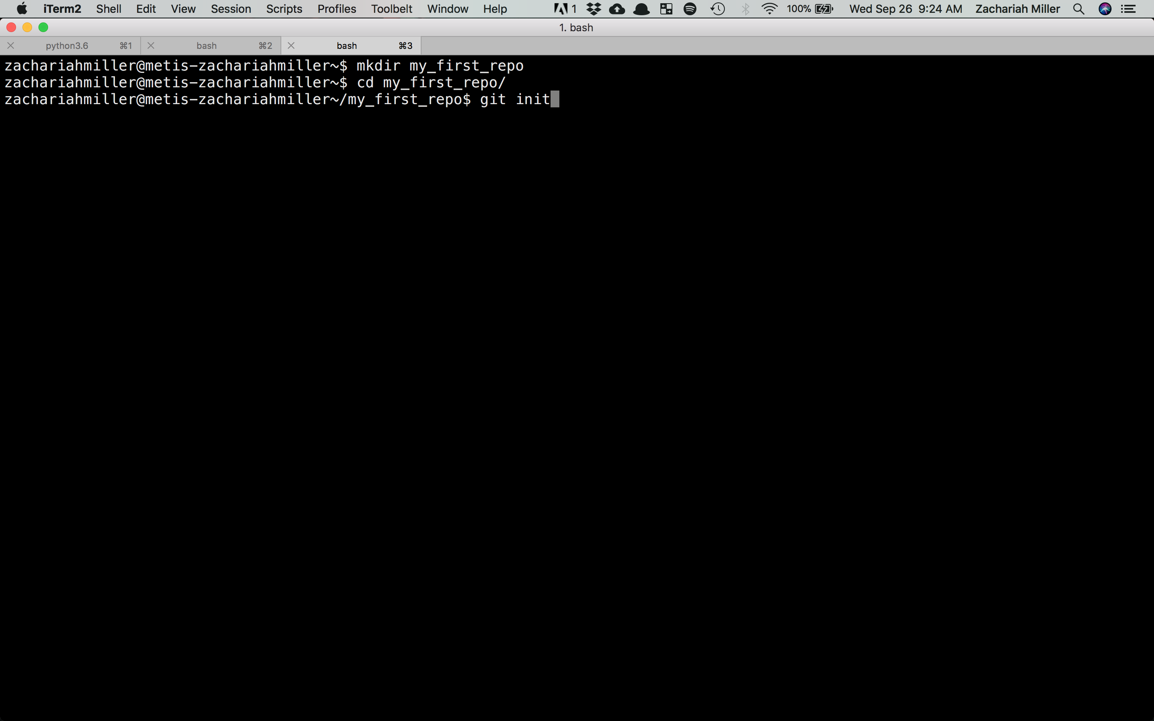

Slide 48
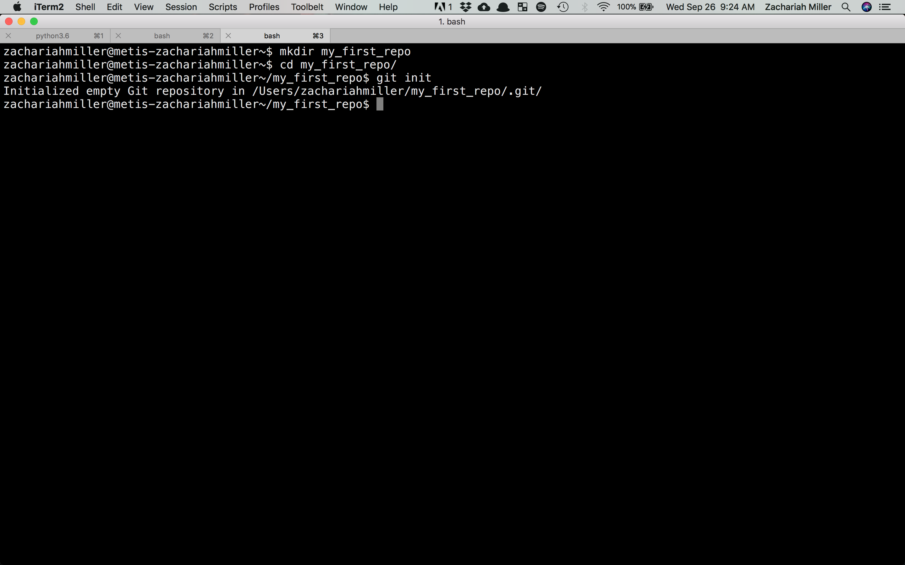

Slide 49
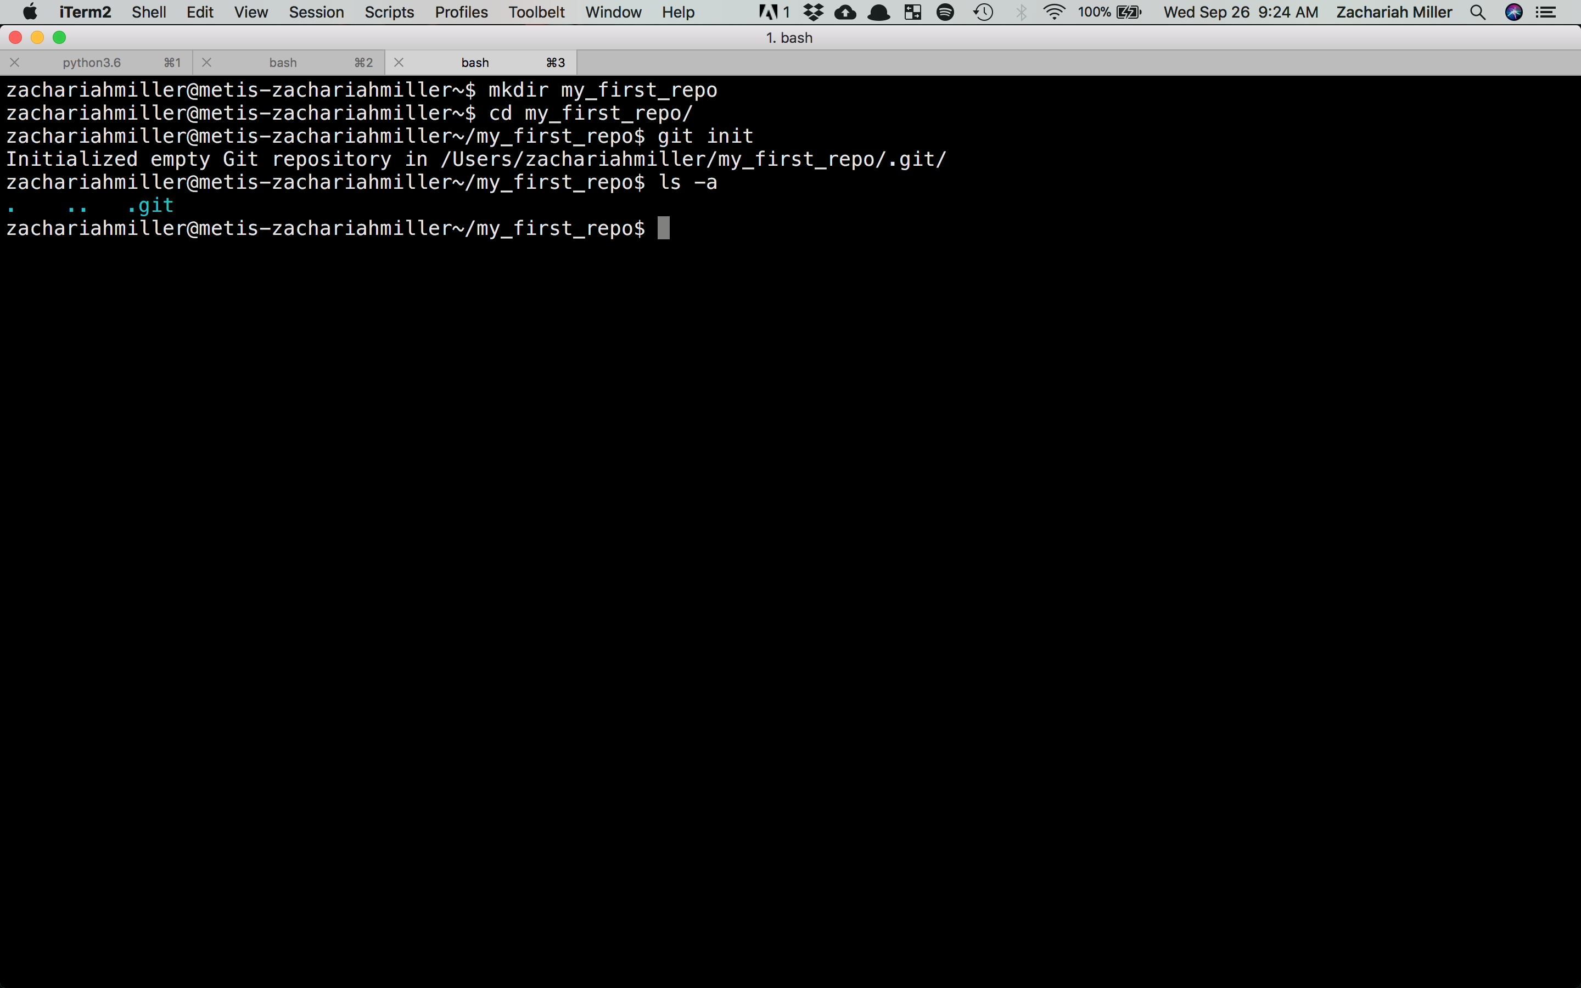

Slide 50
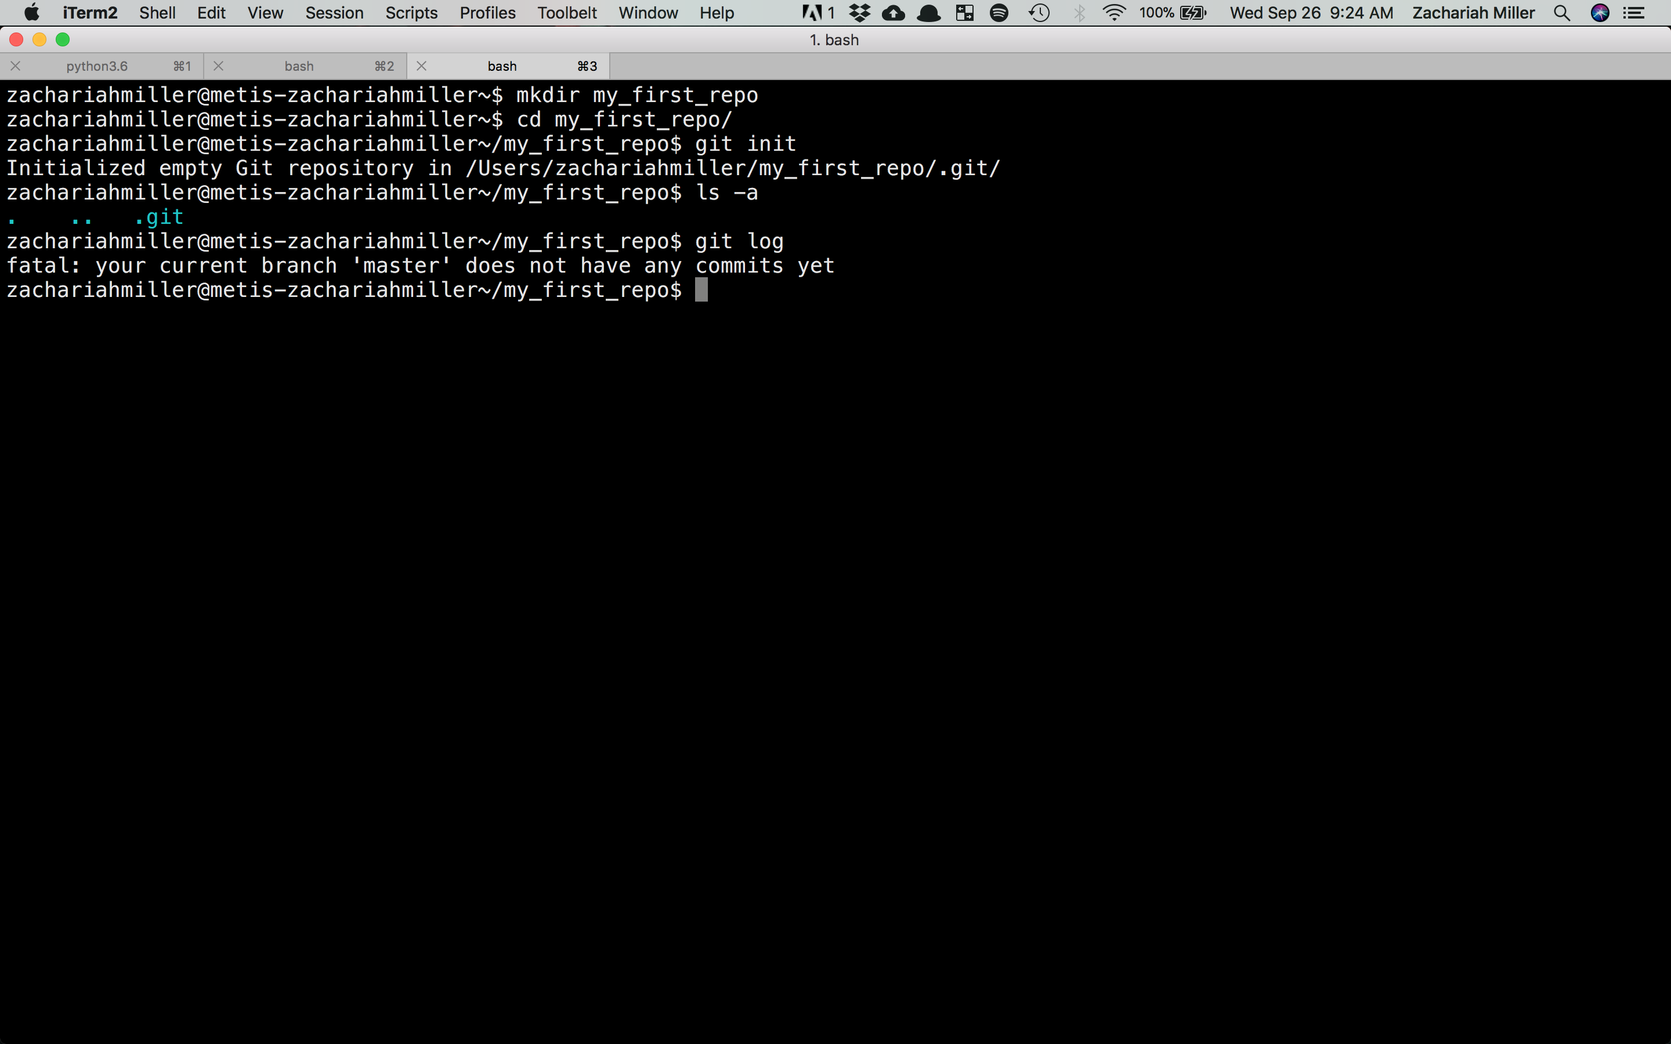

Slide 51
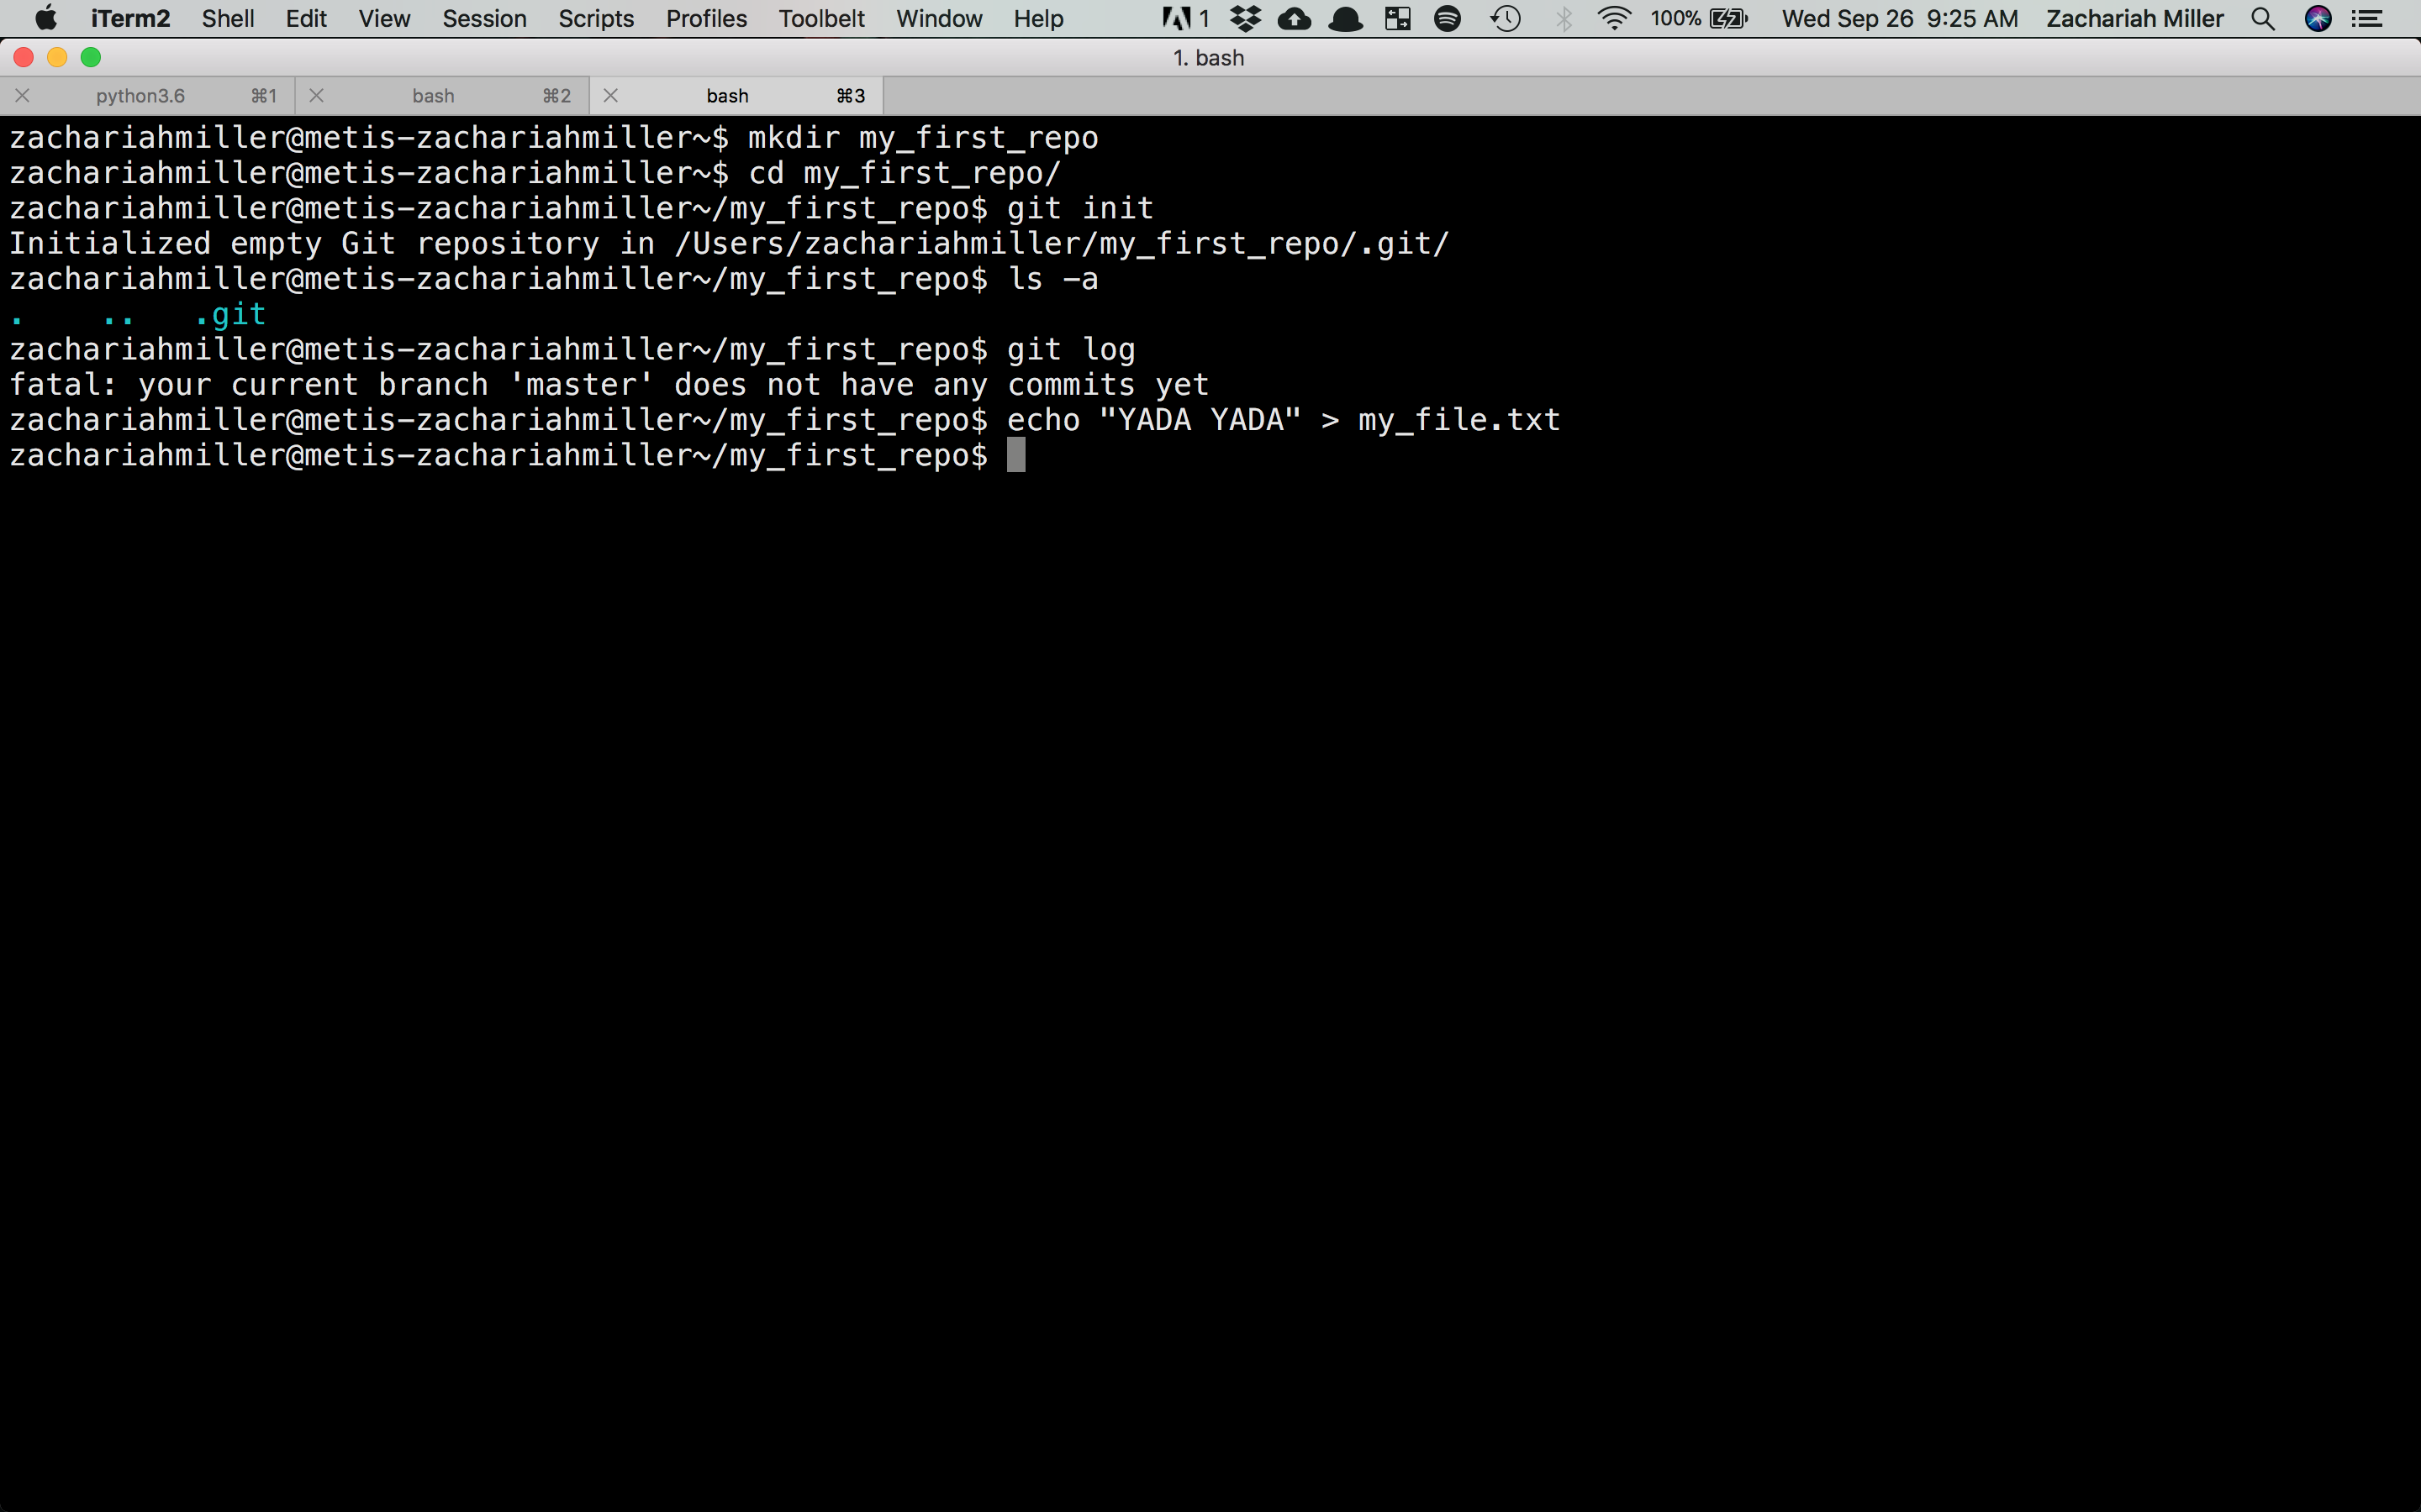

Slide 52
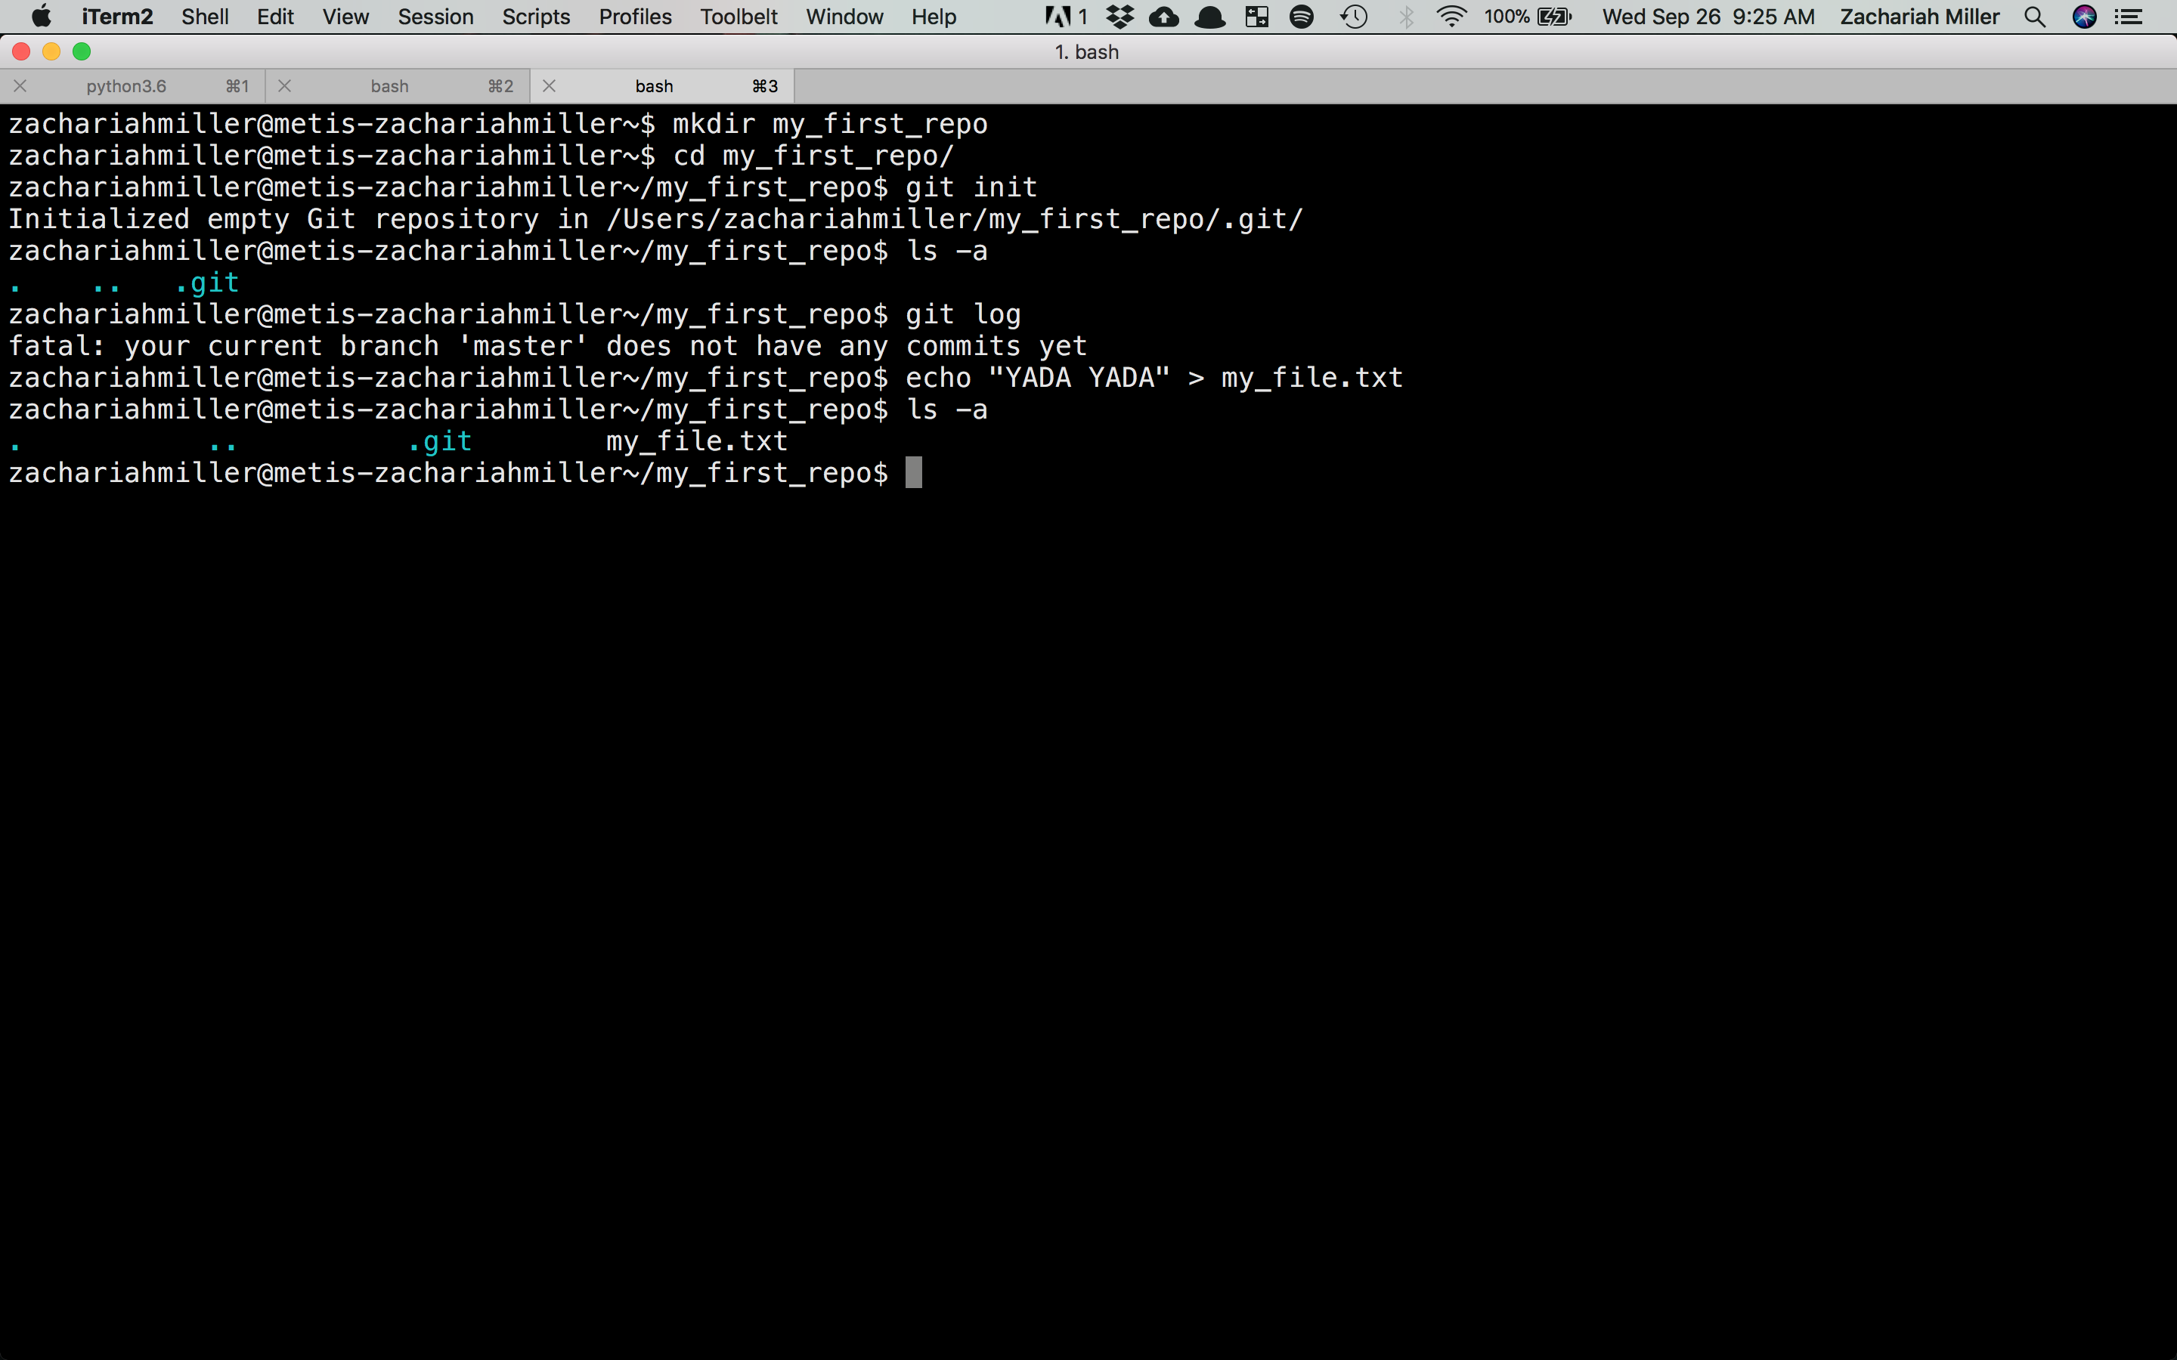

Slide 53
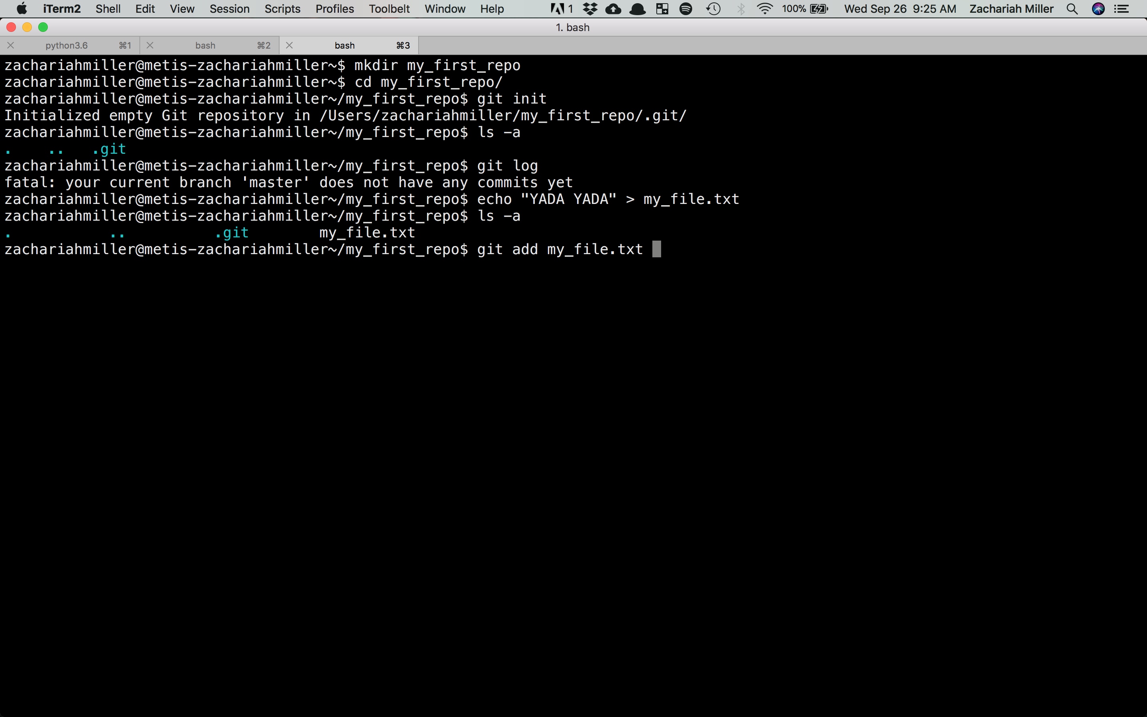

Slide 54
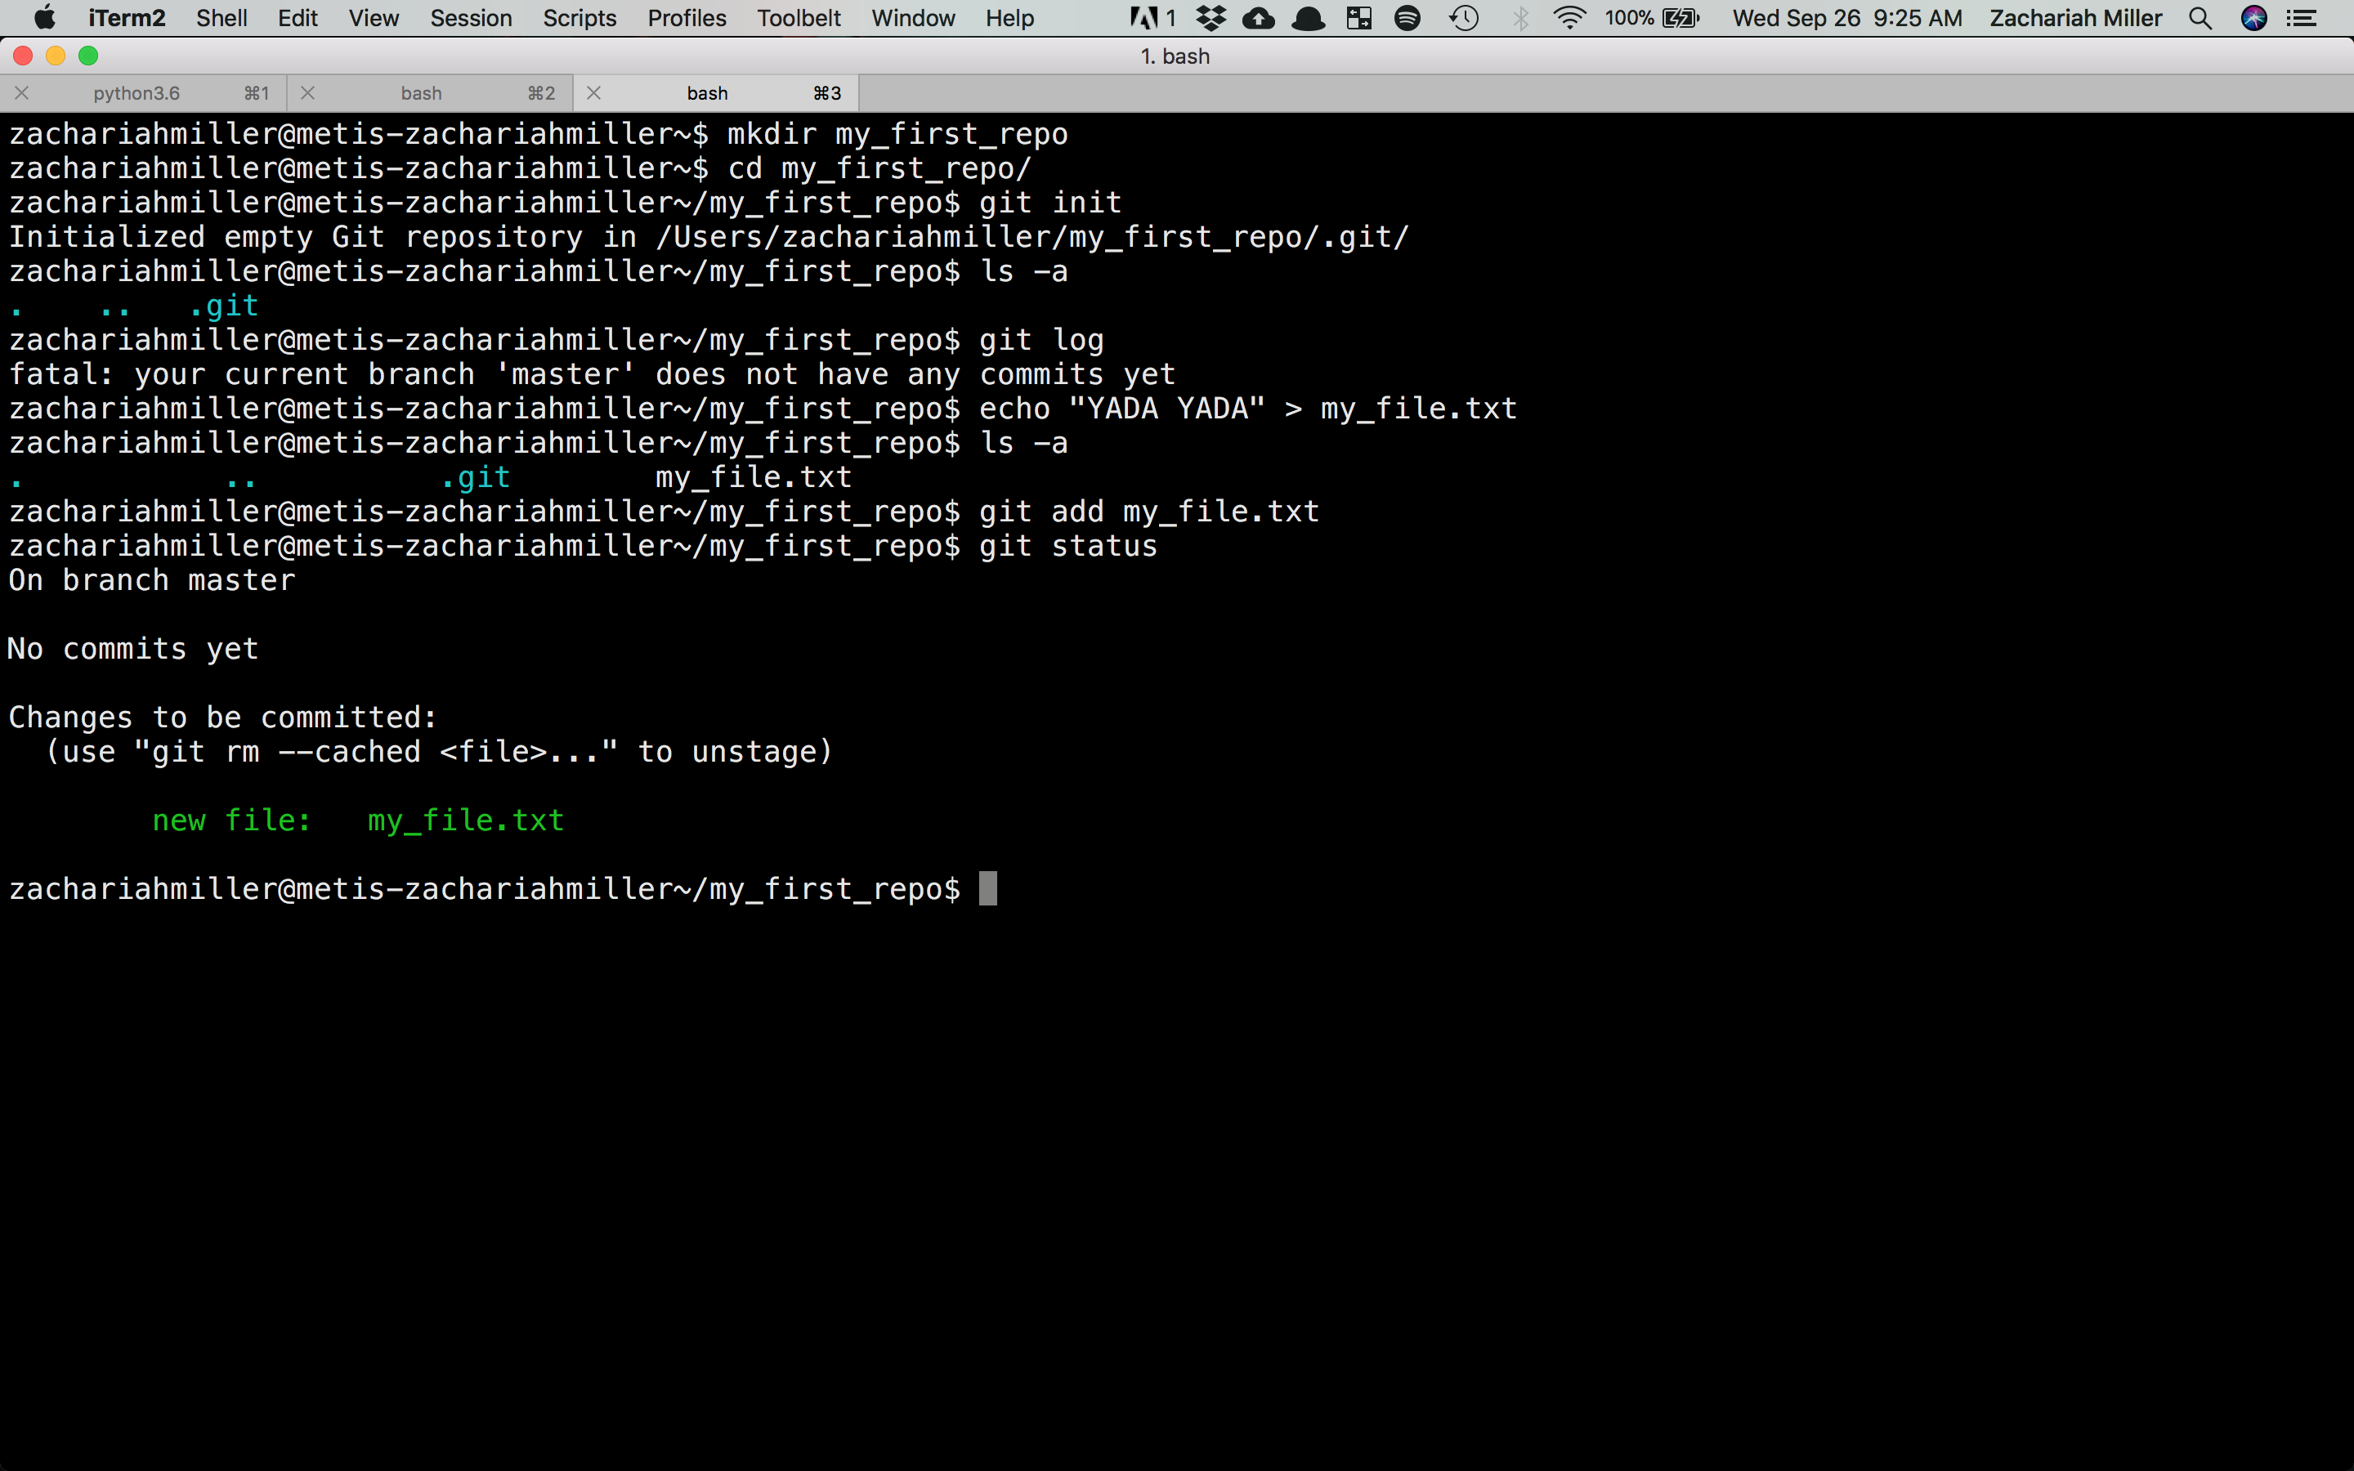

Slide 55
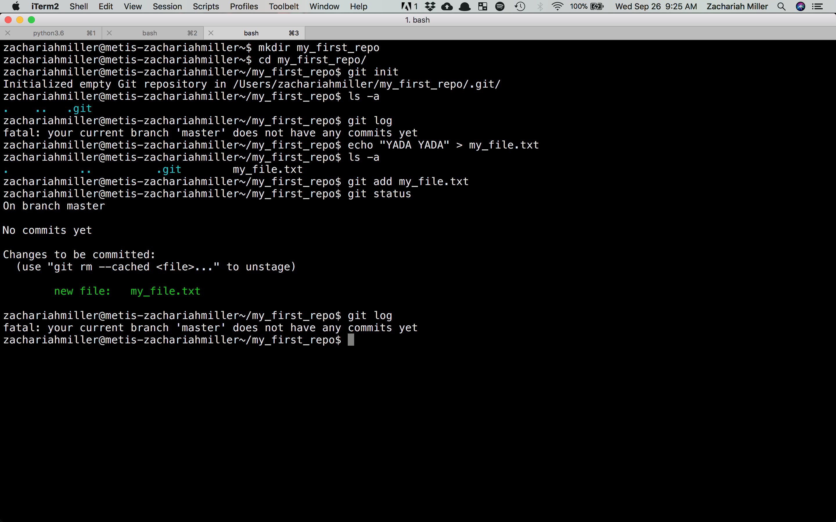

Slide 56
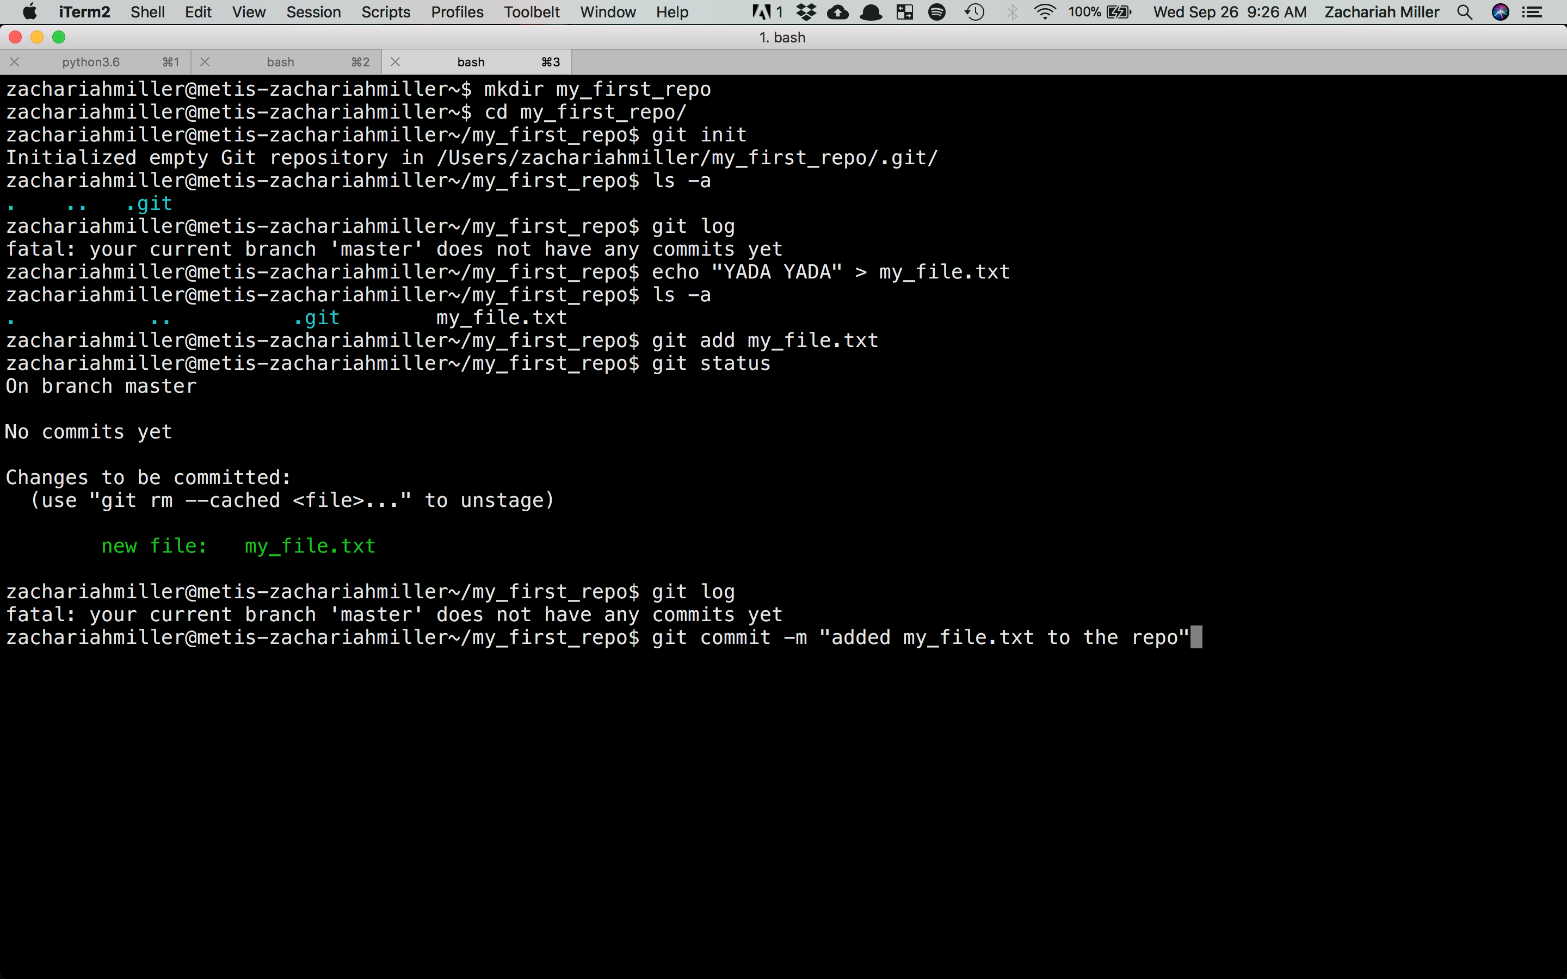

Slide 57
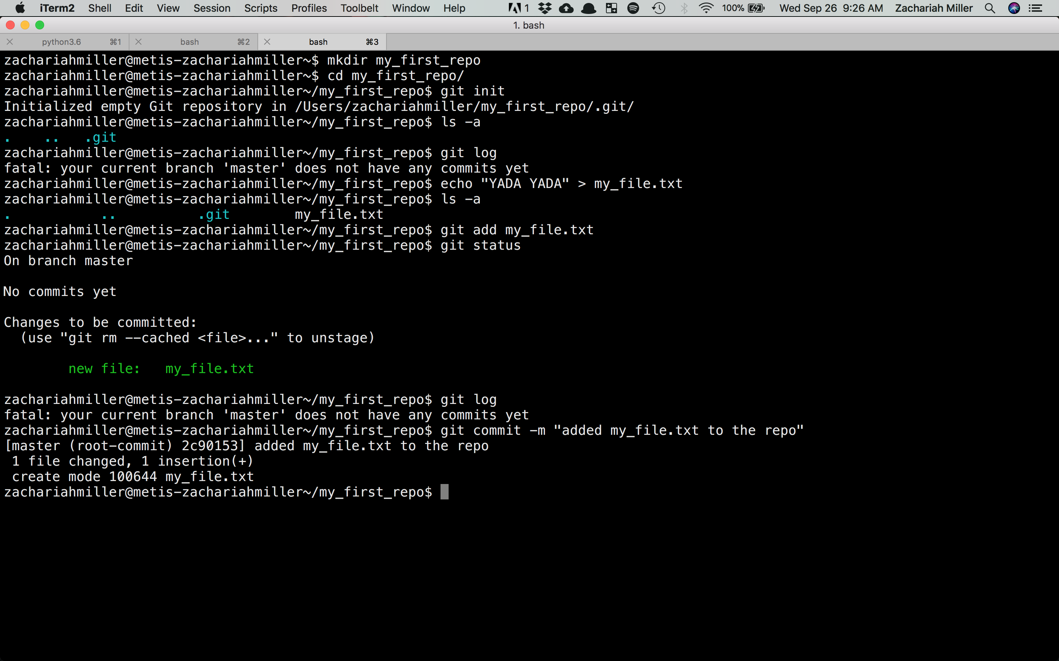

Slide 58
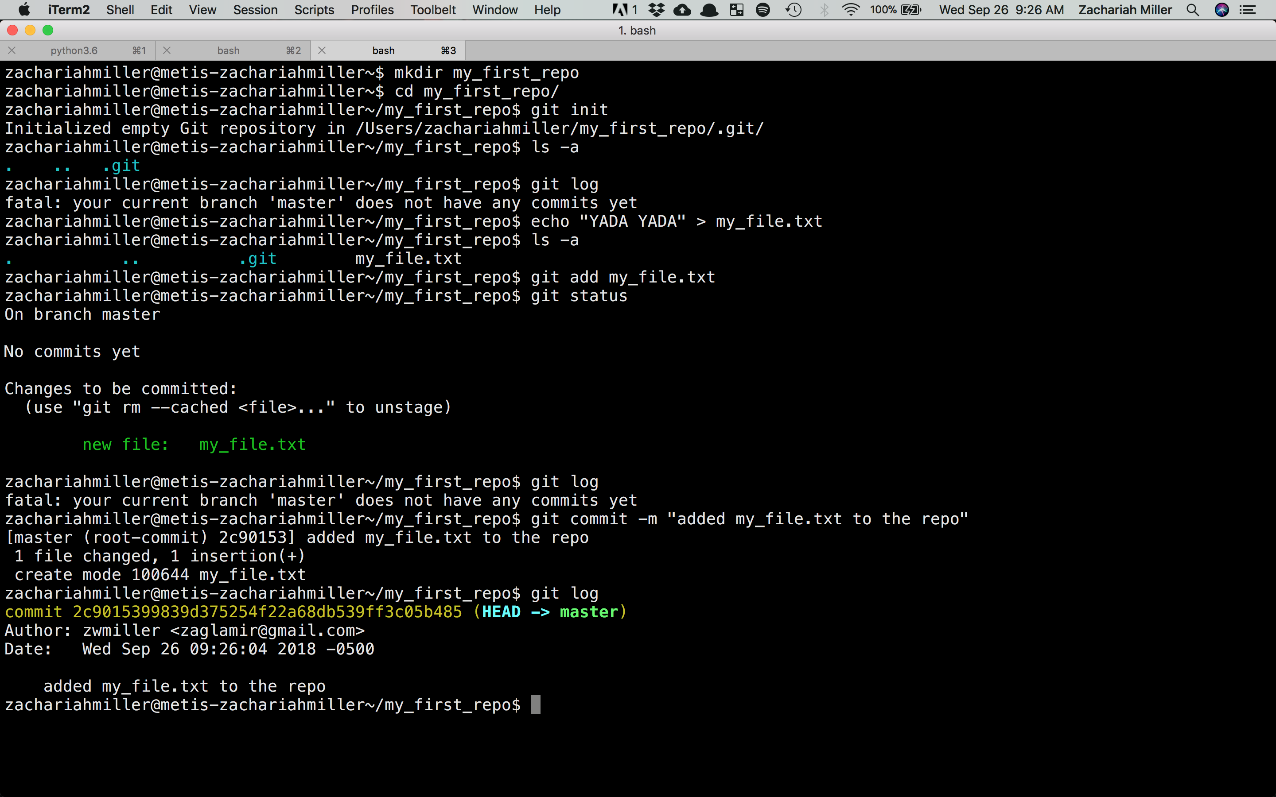

Slide 59
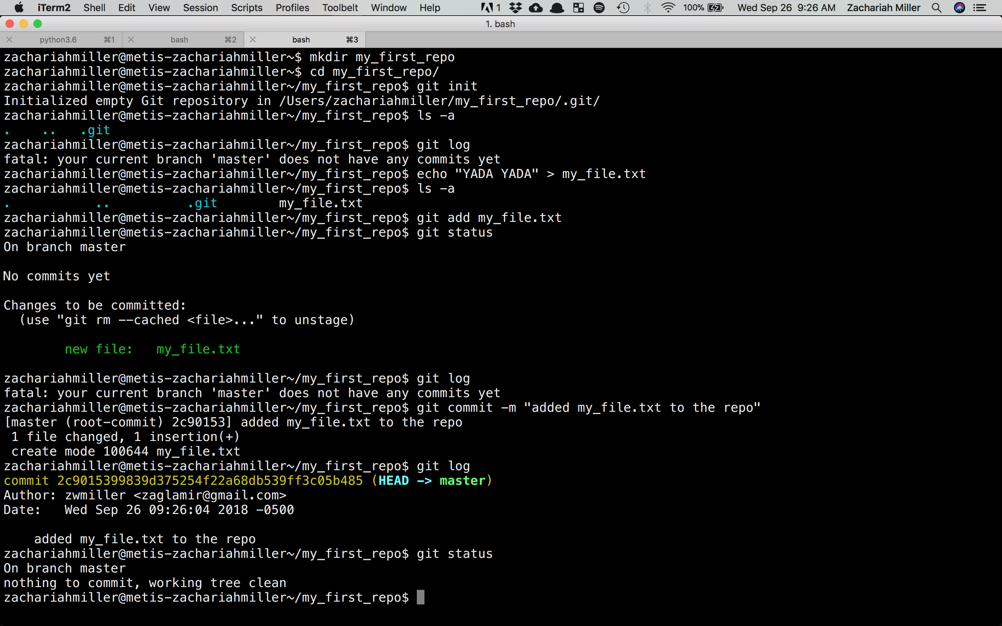

Slide 60
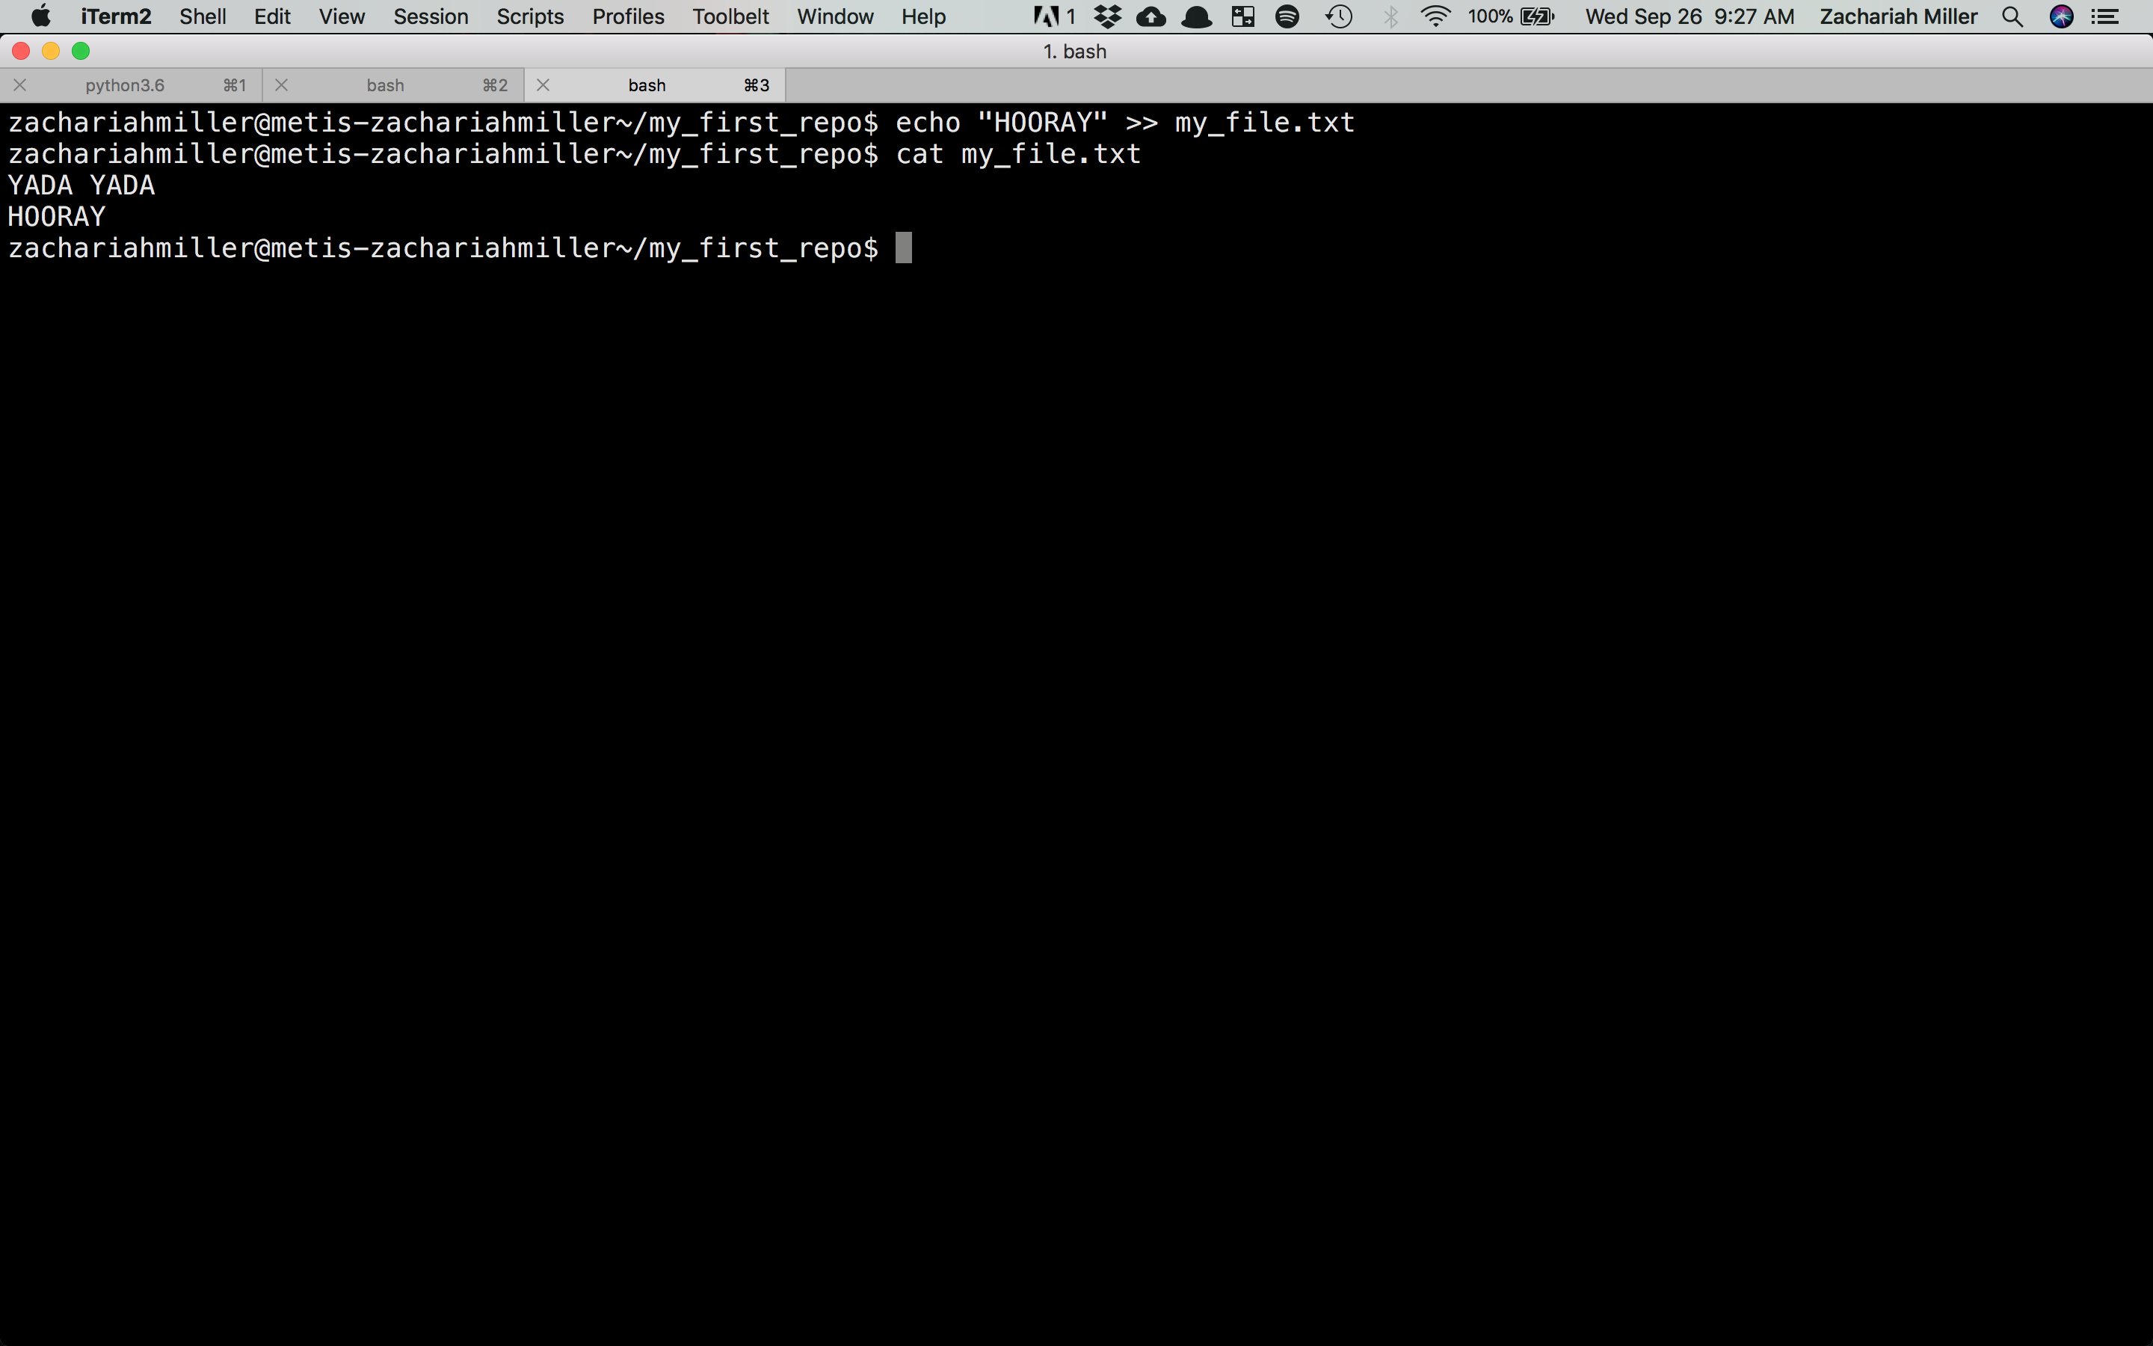
Now, let’s edit the file by appending some new text.
Make a commit following the procedure we just did.
Use git log to prove to yourself there are two commits now.
We’ll run through a solution in about 5 minutes.

Slide 61
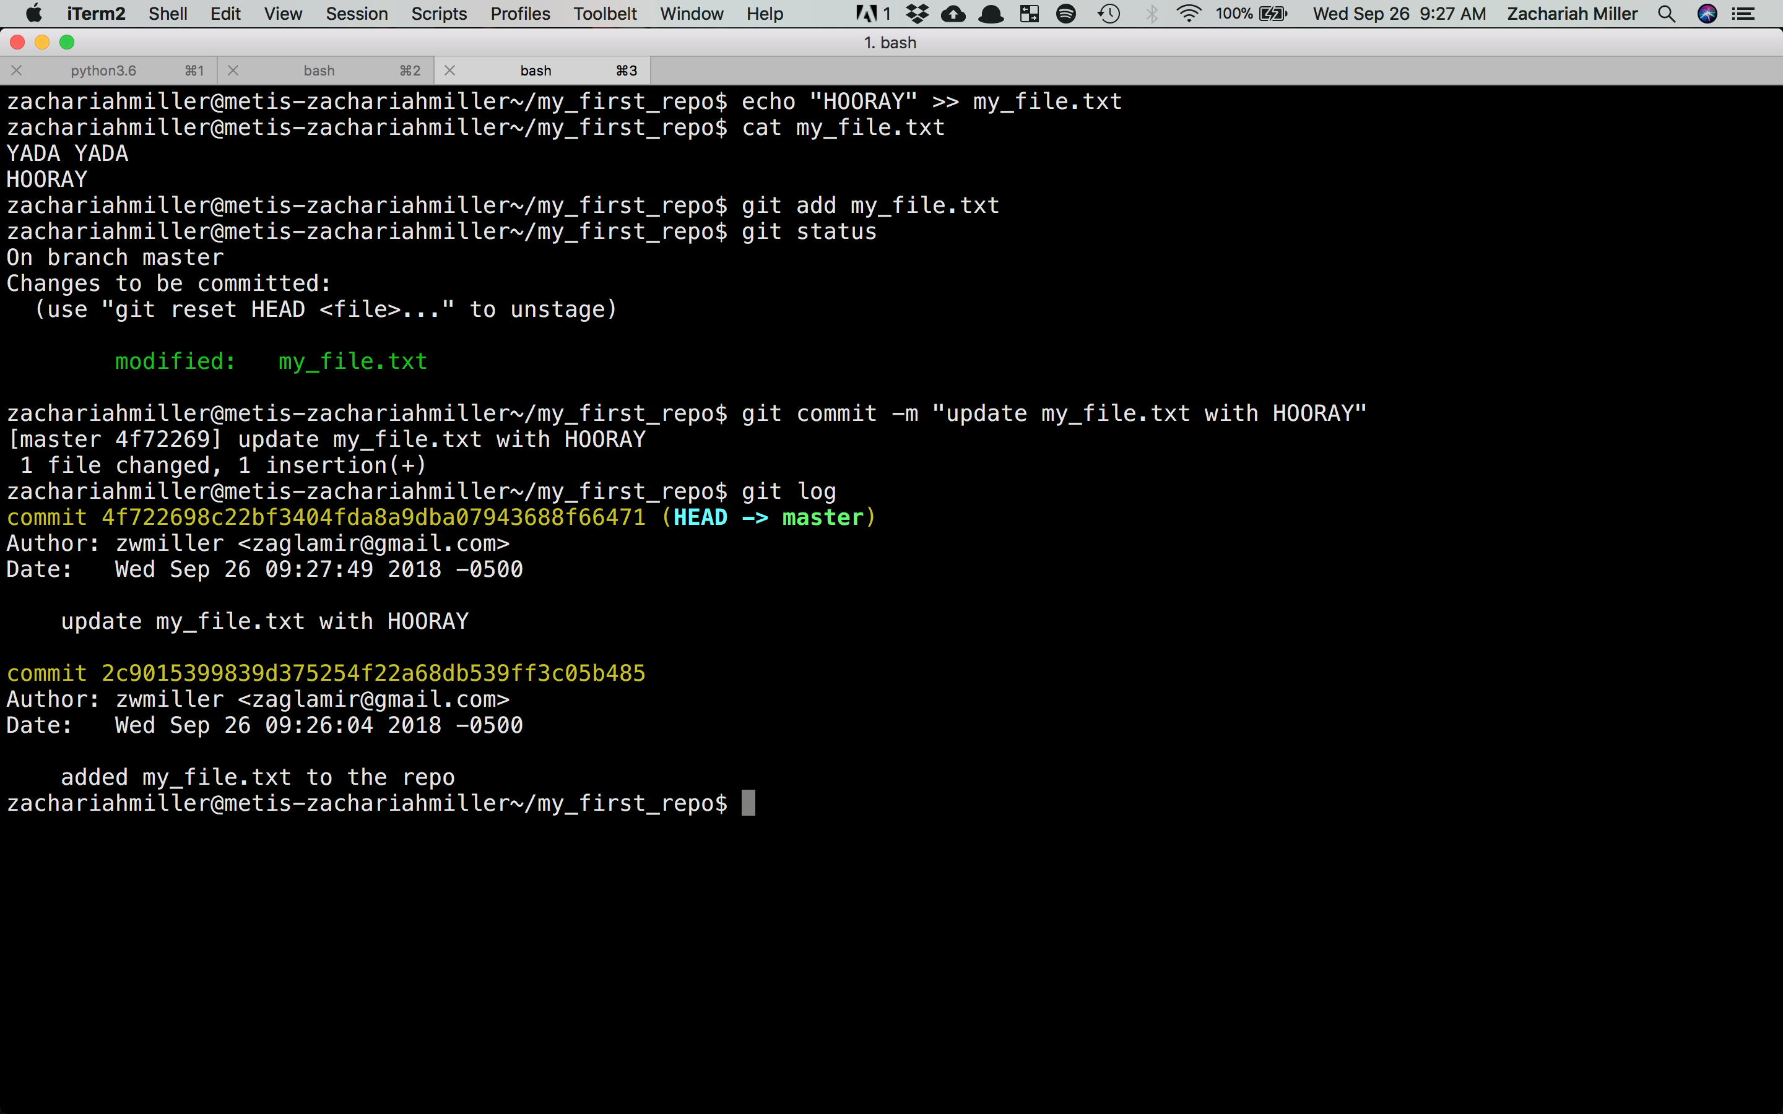

Slide 62
Reverting to a previous point

Slide 63
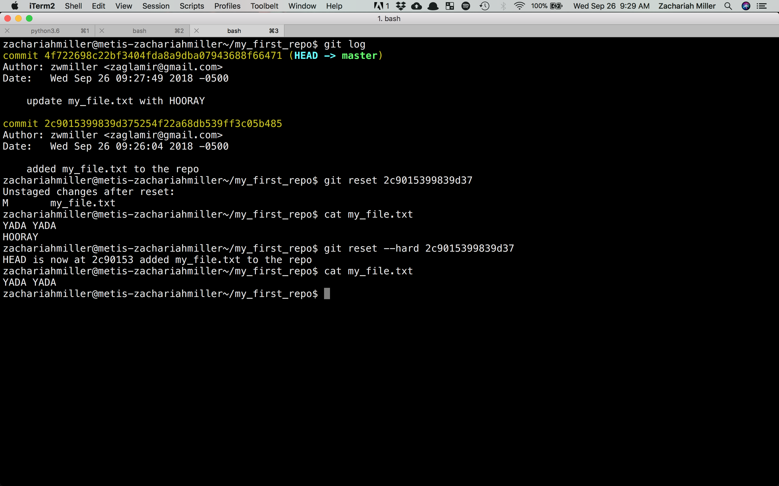

Slide 65
Huh? I said reset!

Slide 67
GitHub: Managing Coding Teams

Slide 68
GitHub
GitHub looks at what git does and asks the question, “what if I want lots of people to be sharing code?”
It adds an online component of code sharing
It adds a new phase to our “3 phases of Git”
It allows the repo to live somewhere other than your computer, so your backups are backed up.

Slide 69
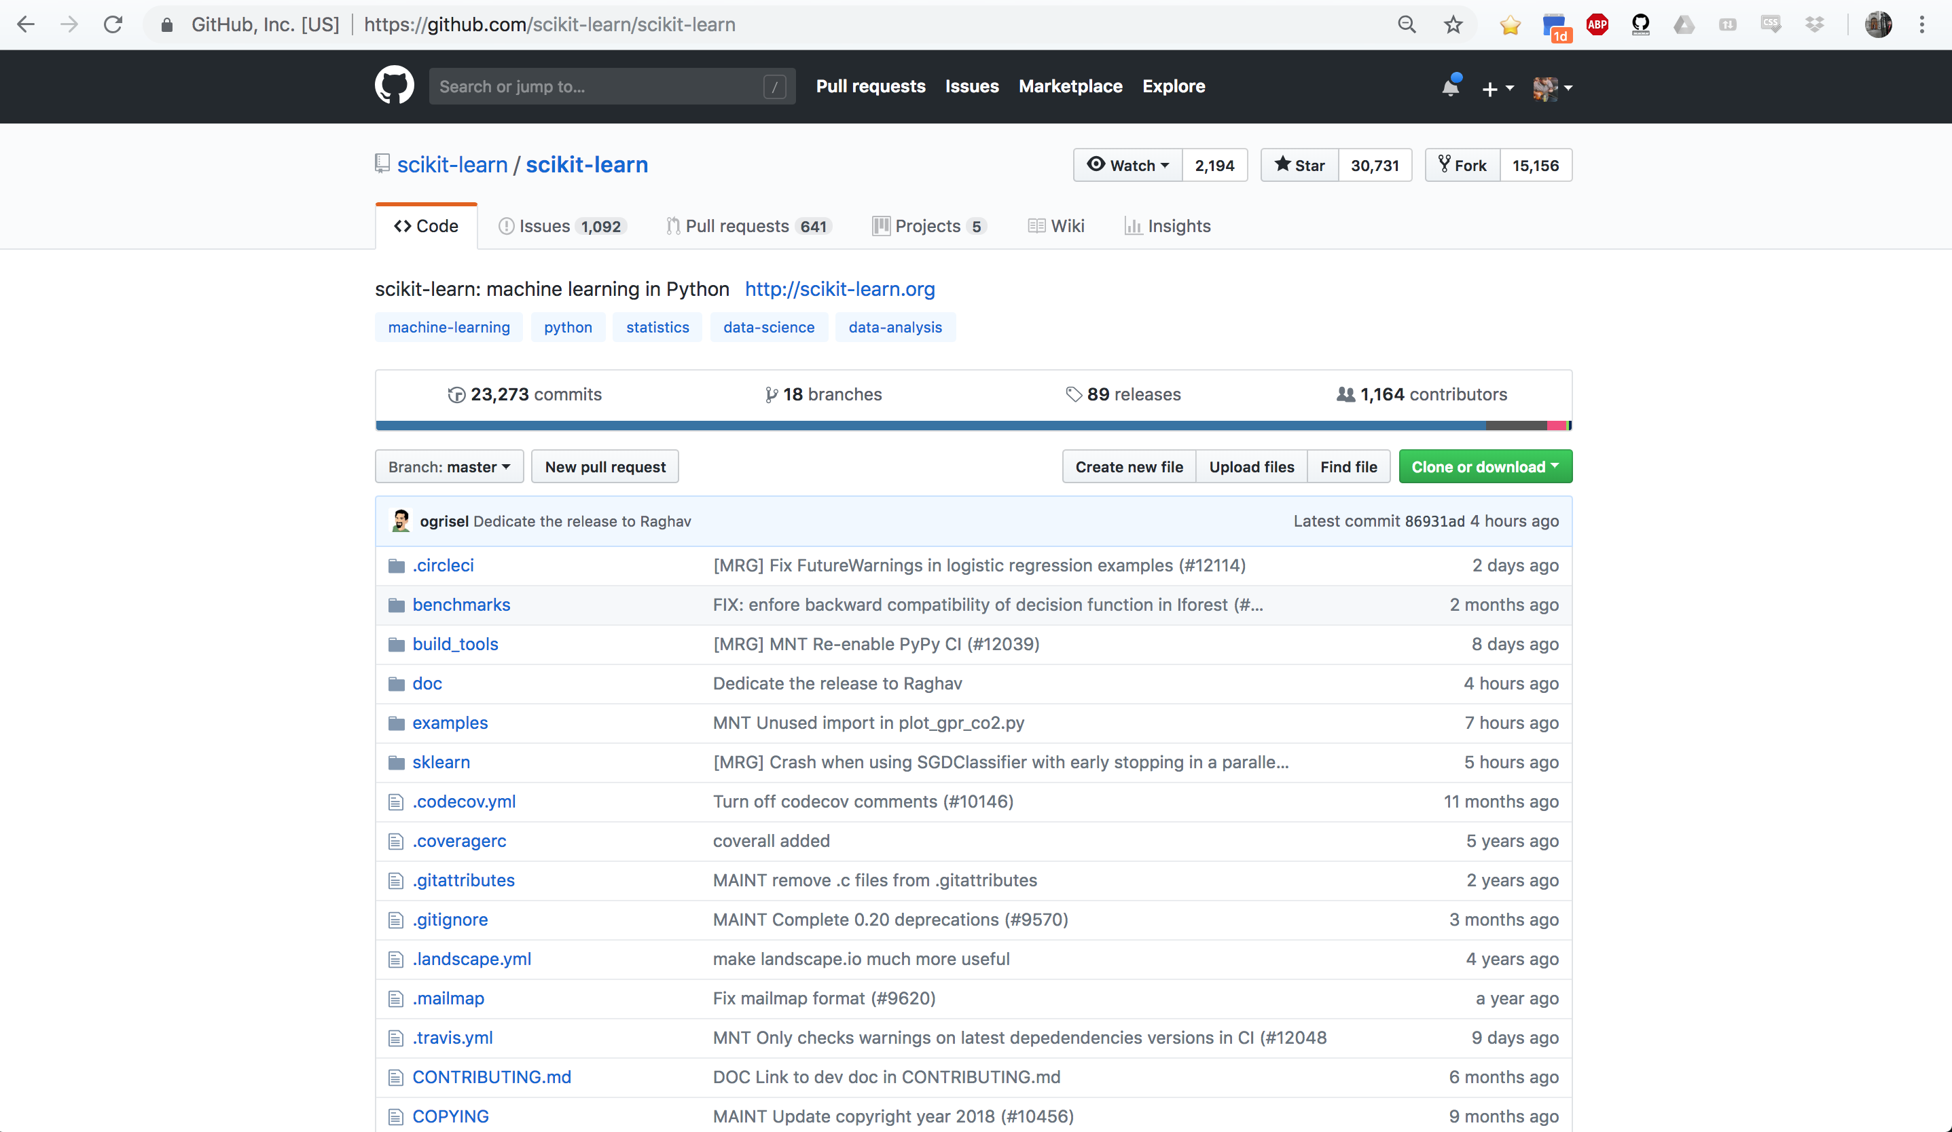

Slide 70
1000+ Coders

Slide 71
23,000+ Commits

Slide 72
All of Scikit Learn

Slide 73
Working Directory
Staging Area
Repository
Remote Repo on GitHub
Code. Code. Code.
Code. Code. Code.
Code. Code. Code.
My Computer
GitHub’s Servers

Slide 74
GitHub: Remote vs Local
We use pushes and pulls to move the current version of our repo between our computer and a “remote” version of the repo.
A push says, “make the remote version look like my code” and in particular it updates any files that changed in the last commits.
A pull says, “bring in any changes that have occurred on the remote version of the repo and make my code match those”

Slide 75
Working Directory
Staging Area
Repository
Remote Repo on GitHub
Code. Code. Code.
Code. Code. Code.
Code. Code. Code.
Push
Code. Code. Code.

Slide 76
Working Directory
Staging Area
Repository
Remote Repo on GitHub
Code. Code. Code.
Code. Code. Code.
Code. Code. Code.
Push
Code. Code. Code.
Teammate makes an edit and push
Code. Code. Whoo!

Slide 77
Working Directory
Staging Area
Repository
Remote Repo on GitHub
Code. Code. Code.
Code. Code. Code.
Code. Code. Code.
Push
Code. Code. Code.
Teammate makes an edit and push
These don’t match now.
Code. Code. Code.
Code. Code. Whoo!

Slide 78
Working Directory
Staging Area
Repository
Remote Repo on GitHub
Code. Code. Code.
Code. Code. Code.
Code. Code. Code.
Push
Code. Code. Code.
Teammate makes an edit and push
Code. Code. Whoo!
Pull
Code. Code. Whoo!

Slide 79
GitHub: Remote vs Local
One subtlety: GitHub only modifies files that have CHANGED since the last time you asked Git to track them. So if I never asked Git to track a certain file (by making an add-commit), even if I push my code, it won’t go to the remote version).

Slide 80
Exercise: Making your repo remote

Slide 81
Let’s start by creating a repo on GitHub called “Test”

Slide 82
Connecting GitHub to our Local Repo
We now have a remote repo (on GitHub) and the local one where we put our test files. Let’s link those together.
First, in the terminal, move to the repo we started earlier. You need to be in the folder where we did the git init earlier.
(or any directory below that)

Slide 83
Connecting GitHub to our Local Repo
We now have a remote repo (on GitHub) and the local one where we put our test files. Let’s link those together.
Terminal:> git remote add origin URL_FROM_GITHUB
This tells git are about to tell it about the non-local version of the repo

Slide 84
Connecting GitHub to our Local Repo
We now have a remote repo (on GitHub) and the local one where we put our test files. Let’s link those together.
Terminal:> git remote add origin URL_FROM_GITHUB
This tells git we’re adding a new remote place to interface with

Slide 85
Connecting GitHub to our Local Repo
We now have a remote repo (on GitHub) and the local one where we put our test files. Let’s link those together.
Terminal:> git remote add origin URL_FROM_GITHUB
This tells git that we’re going to call this remote place “origin” (it’s convention)

Slide 86
Connecting GitHub to our Local Repo
We now have a remote repo (on GitHub) and the local one where we put our test files. Let’s link those together.
Terminal:> git remote add origin URL_FROM_GITHUB
This is specific to your repo and tells git where the remote repo lives.

Slide 87
Connecting GitHub to our Local Repo
Make sure it worked by testing your remote locations using:
I see an output like this:
Terminal:> git remote -v
origin https://github.com/ZWMiller/test (fetch)
origin https://github.com/ZWMiller/test (push)

Slide 88
Connecting GitHub to our Local Repo
Now let’s move our code to GitHub
When we go back to our GitHub and refresh, we should see out files there!
Terminal:> git push origin master

Slide 89
Connecting GitHub to our Local Repo
Now let’s move our code to GitHub
Terminal:> git push origin master
This told git we wanted to move our commit history up to GitHub

Slide 90
Connecting GitHub to our Local Repo
Now let’s move our code to GitHub
Terminal:> git push origin master
This told git to use the remote place we just created called “origin”

Slide 91
Connecting GitHub to our Local Repo
Now let’s move our code to GitHub
Terminal:> git push origin master
This told git to put those changes on the “master” branch. We’ll talk about branches later, but master is the most important one.

Slide 92
Summary
Git and GitHub are powerful tools for maintaining good code.
They allow us to checkpoint via commits, and give us the power to move back in time if we break our code.
GitHub allows us to share our code with others and allows multiple people to make changes to the code.

Slide 93
Best Practice
A smart person would keep a GitHub repo for all of their projects. They would create one right after this lecture for project 1. That way, if they happen to spill coffee on their laptop, their code is backed up.
It’s a good idea to commit/push often. I usually do so after every completed “point” in my code. Finished a few functions that now work together? Commit. Updated comments in the code? Commit.

Slide 94

QUESTIONS?

